Slide 1


Enabling Accurate, Fast, and Memory-Efficient Genome Analysis via Efficient and Intelligent Algorithms
Can Firtina
canfirtina@gmail.com
10 January 2022
METU Graduate Seminar in Bioinformatics

Slide 2
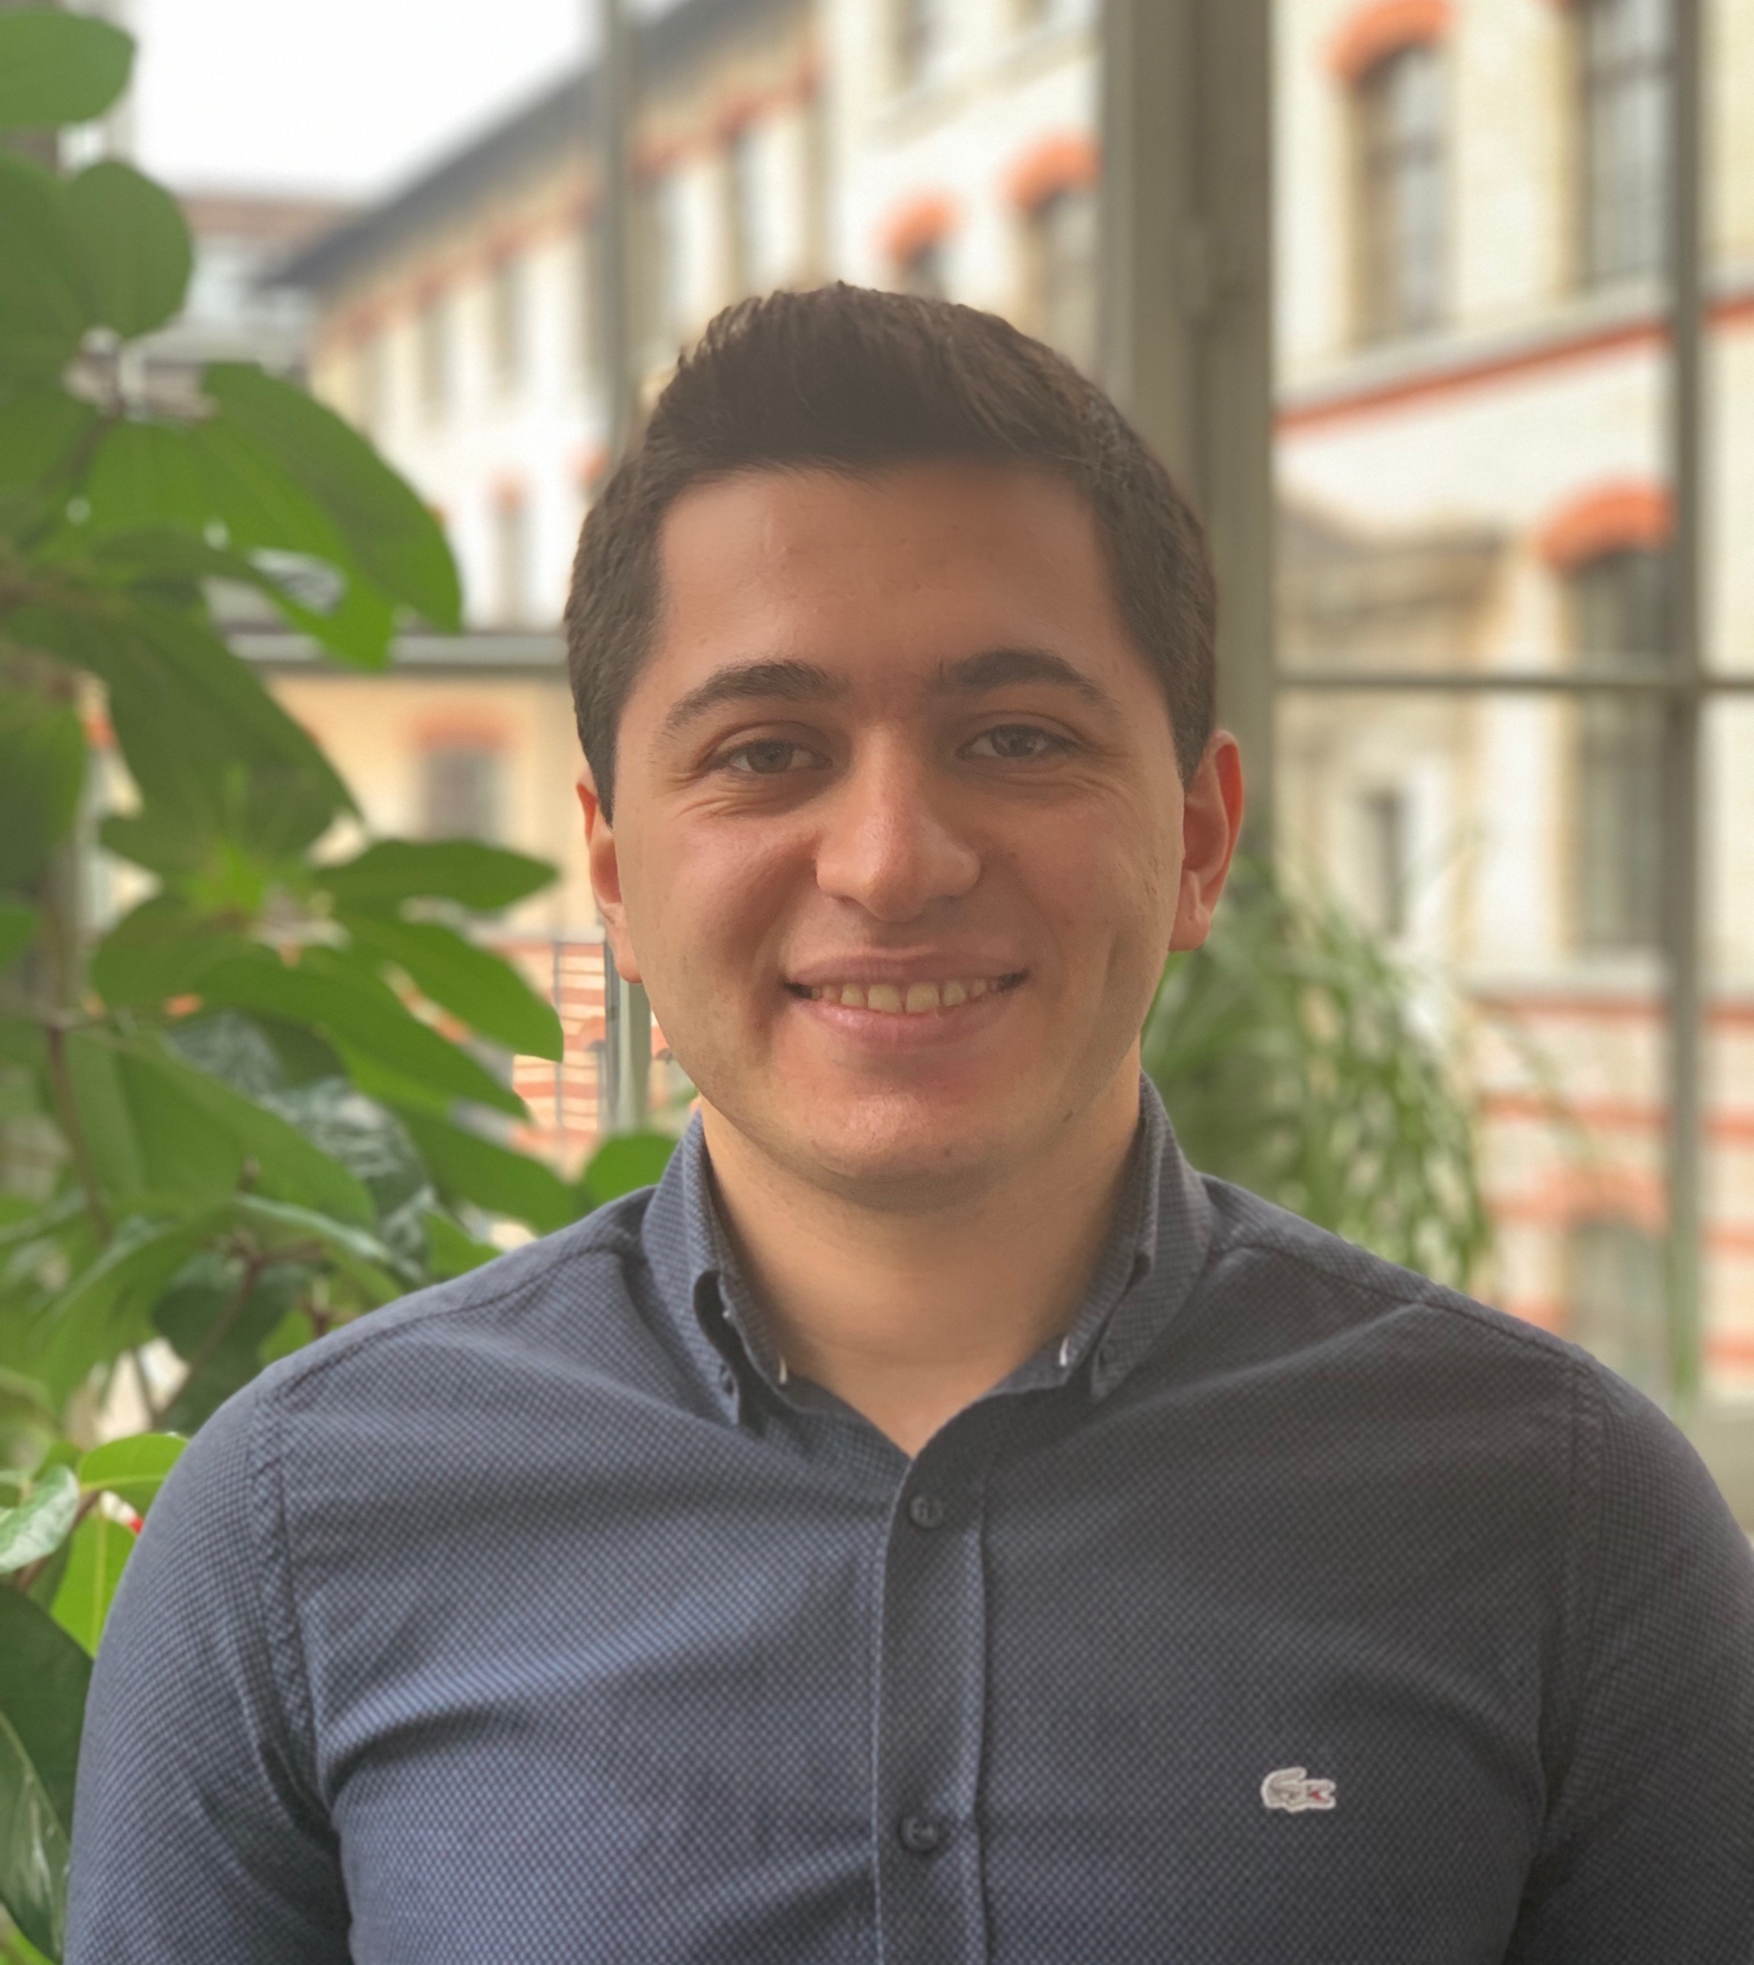
Brief Self Introduction
Ph.D. Student in the SAFARI Research Group
Research interests:
Computational biology, accelerating genome analysis
Some selected works:
Can Firtina+, “BLEND: A Fast, Memory-Efficient, and Accurate Mechanism to Find Fuzzy Seed Matches,” arXiv, Dec. 2021.
Can Firtina+, “Apollo: a sequencing-technology-independent, scalable and accurate assembly polishing algorithm,” Bioinformatics, Jun. 2020.
Damla Senol Cali+ “GenASM: A High-Performance, Low-Power Approximate String Matching Acceleration Framework for Genome Sequence Analysis,” in MICRO 2020.
Jeremie S. Kim+ “AirLift: A Fast and Comprehensive Technique for Translating Alignments between Reference Genomes,” arXiv, 2019.
Get to know us and our research
https://safari.ethz.ch/
Contact me: canfirtina@gmail.com

Slide 3
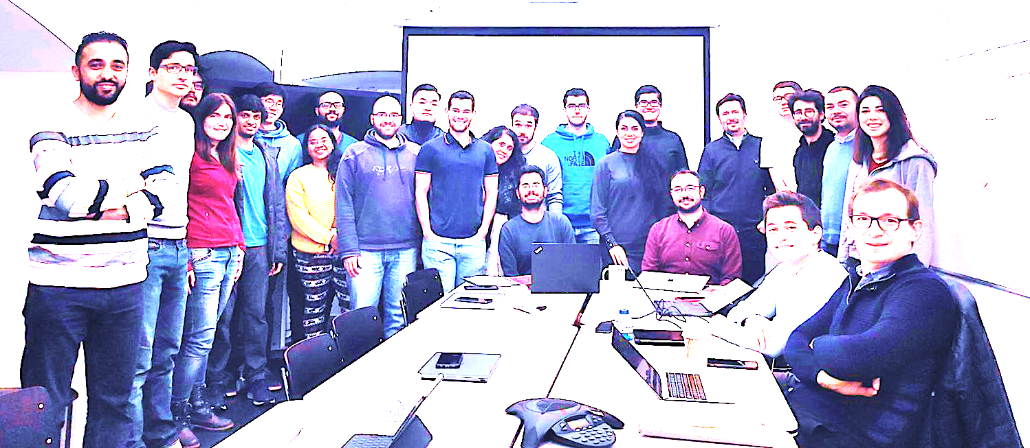

Onur Mutlu’s SAFARI Research Group
Computer architecture, HW/SW, systems, bioinformatics, security, memory
40+ Researchers
Think BIG, Aim HIGH!
https://safari.ethz.ch

Slide 4
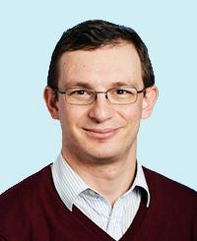
Professor Mutlu
Onur Mutlu
Full Professor @ ETH Zurich ITET (INFK), since September 2015
Strecker Professor @ Carnegie Mellon University ECE/CS, 2009-2016, 2016-…
PhD from UT-Austin, worked at Google, VMware, Microsoft Research, Intel, AMD
https://people.inf.ethz.ch/omutlu/
omutlu@gmail.com (Best way to reach)
https://people.inf.ethz.ch/omutlu/projects.htm
Research and Teaching in:
Computer architecture, computer systems, hardware security, bioinformatics
Memory and storage systems
Hardware security, safety, predictability
Fault tolerance
Hardware/software cooperation
Architectures for bioinformatics, health, medicine
…

Slide 5
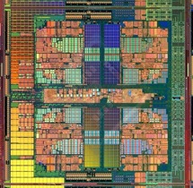
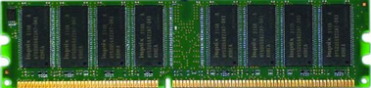
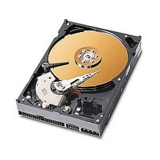
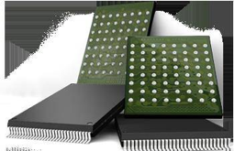
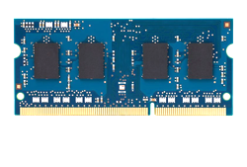
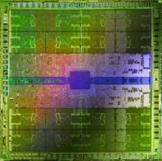
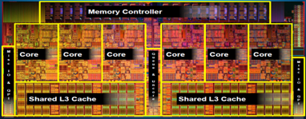
Current Research Mission
Computer architecture, HW/SW, systems, bioinformatics, security
Hybrid Main Memory
Heterogeneous
Processors and
Accelerators
Persistent Memory/Storage
Graphics and Vision Processing
Build fundamentally better architectures

Slide 6
Four Key Current Directions
Fundamentally Secure/Reliable/Safe Architectures
Fundamentally Energy-Efficient Architectures
Memory-centric (Data-centric) Architectures
Fundamentally Low-Latency and Predictable Architectures
Architectures for AI/ML, Genomics, Medicine, Health

Slide 7
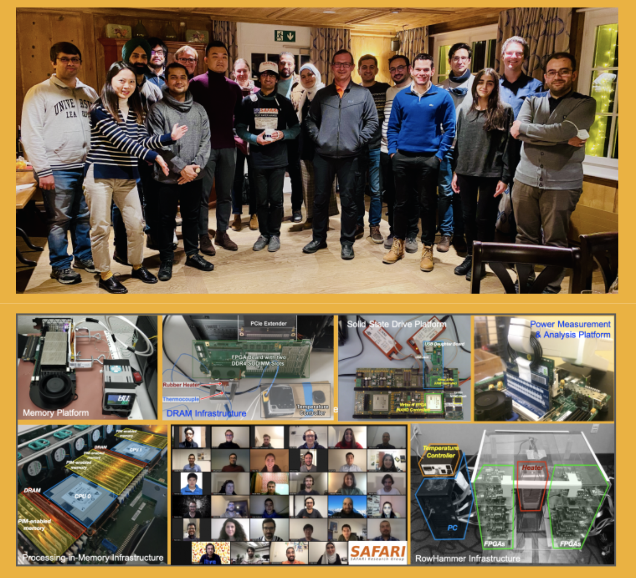
SAFARI Newsletter December 2021 Edition
https://safari.ethz.ch/safari-newsletter-december-2021

Slide 8
Research & Teaching: Some Overview Talks
https://www.youtube.com/onurmutlulectures
Future Computing Architectures
https://www.youtube.com/watch?v=kgiZlSOcGFM&list=PL5Q2soXY2Zi8D_5MGV6EnXEJHnV2YFBJl&index=1
Enabling In-Memory Computation
https://www.youtube.com/watch?v=njX_14584Jw&list=PL5Q2soXY2Zi8D_5MGV6EnXEJHnV2YFBJl&index=16
Accelerating Genome Analysis
https://www.youtube.com/watch?v=r7sn41lH-4A&list=PL5Q2soXY2Zi8D_5MGV6EnXEJHnV2YFBJl&index=41
Rethinking Memory System Design
https://www.youtube.com/watch?v=F7xZLNMIY1E&list=PL5Q2soXY2Zi8D_5MGV6EnXEJHnV2YFBJl&index=3
Intelligent Architectures for Intelligent Machines
https://www.youtube.com/watch?v=c6_LgzuNdkw&list=PL5Q2soXY2Zi8D_5MGV6EnXEJHnV2YFBJl&index=25
The Story of RowHammer
https://www.youtube.com/watch?v=sgd7PHQQ1AI&list=PL5Q2soXY2Zi8D_5MGV6EnXEJHnV2YFBJl&index=39

Slide 9
Referenced Papers, Talks, Artifacts
All are available at
https://safari.ethz.ch
https://people.inf.ethz.ch/omutlu/projects.htm
http://scholar.google.com/citations?user=7XyGUGkAAAAJ&hl=en
https://www.youtube.com/onurmutlulectures
https://github.com/CMU-SAFARI/

Slide 10
Accelerating Genome Analysis

Slide 11
The Problem
Computing
is Bottlenecked by Data

Slide 12
Data is Key for AI, ML, Genomics, …
Important workloads are all data intensive
They require rapid and efficient processing of large amounts of data
Data is increasing
We can generate more than we can process

Slide 13
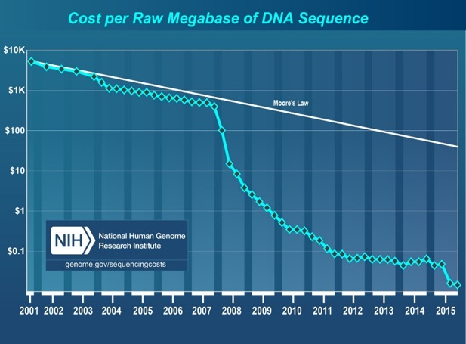
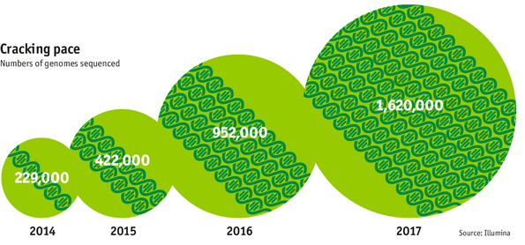

Data is Key for Future Workloads
development of high-throughput sequencing (HTS) technologies
Number of Genomes Sequenced
http://www.economist.com/news/21631808-so-much-genetic-data-so-many-uses-genes-unzipped

Slide 14

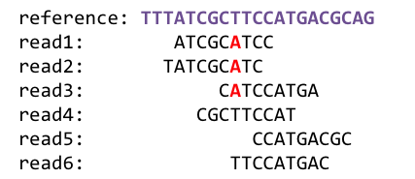
1
Sequencing
Genome Analysis
Read Mapping
2
Data → performance & energy bottleneck
Variant Calling
Scientific Discovery
3
4

Slide 15



Lack of Specialized Compute Capability
Specialized Machine
for Sequencing
General-Purpose Machine
for Analysis
FAST SLOW

Slide 16


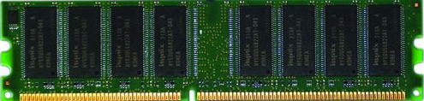
Data Movement Dominates Performance
Data movement dominates performance and is a major system energy bottleneck (accounting for 40%-62%)
Data Movement
Sequencing
Machine
Storage (SSD/HDD)
Main Memory
Microprocessor
Single memory request consumes >160x-800x more energy compared to performing an addition operation
✻ Boroumand et al., “Google Workloads for Consumer Devices: Mitigating Data Movement Bottlenecks,” ASPLOS 2018
★ Kestor et al., “Quantifying the Energy Cost of Data Movement in Scientific Applications,” IISWC 2013
☆ Pandiyan and Wu, “Quantifying the energy cost of data movement for emerging smart phone workloads on mobile platforms,” IISWC 2014

Slide 17
Read Mapping Execution Time
>60%
of the read mapper’s execution time is spent in sequence alignment
minimap2
ONT FASTQ size: 103MB (151 reads), Mean length: 356,403 bp, std: 173,168 bp, longest length: 817,917 bp

Slide 18


Large Search Space for Mapping Location
98%
of candidate locations have high dissimilarity with a given read
Cheng et al, BMC bioinformatics (2015)
Xin et al, BMC genomics (2013)

Slide 19
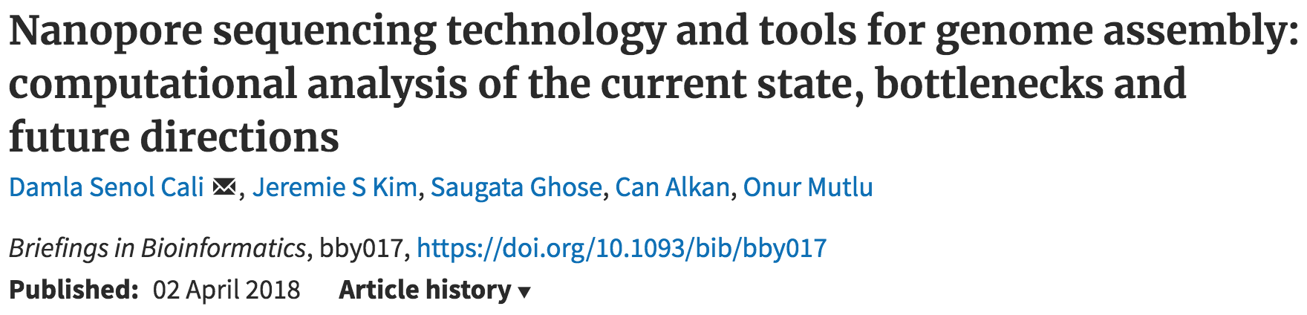
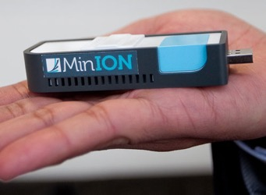
New Genome Sequencing Technologies
Oxford Nanopore MinION
Senol Cali+, “Nanopore Sequencing Technology and Tools for Genome
Assembly: Computational Analysis of the Current State, Bottlenecks
and Future Directions,” Briefings in Bioinformatics, 2018.
[Open arxiv.org version]

Slide 20
New Genome Sequencing Technologies
Oxford Nanopore MinION
Senol Cali+, “Nanopore Sequencing Technology and Tools for Genome
Assembly: Computational Analysis of the Current State, Bottlenecks
and Future Directions,” Briefings in Bioinformatics, 2018.
[Preliminary arxiv.org version]
Data → performance & energy bottleneck

Slide 21
We need intelligent algorithms and intelligent architectures
that handle data well

Slide 22
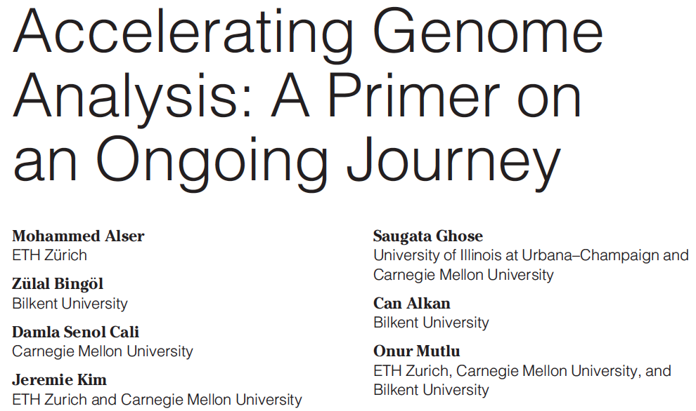
Accelerating Genome Analysis [IEEE MICRO 2020]
Mohammed Alser, Zulal Bingol, Damla Senol Cali, Jeremie Kim, Saugata Ghose, Can Alkan, and Onur Mutlu, "Accelerating Genome Analysis: A Primer on an Ongoing Journey" IEEE Micro (IEEE MICRO), Vol. 40, No. 5, pages 65-75, September/October 2020. [Slides (pptx)(pdf)] [Talk Video (1 hour 2 minutes)]

Slide 23
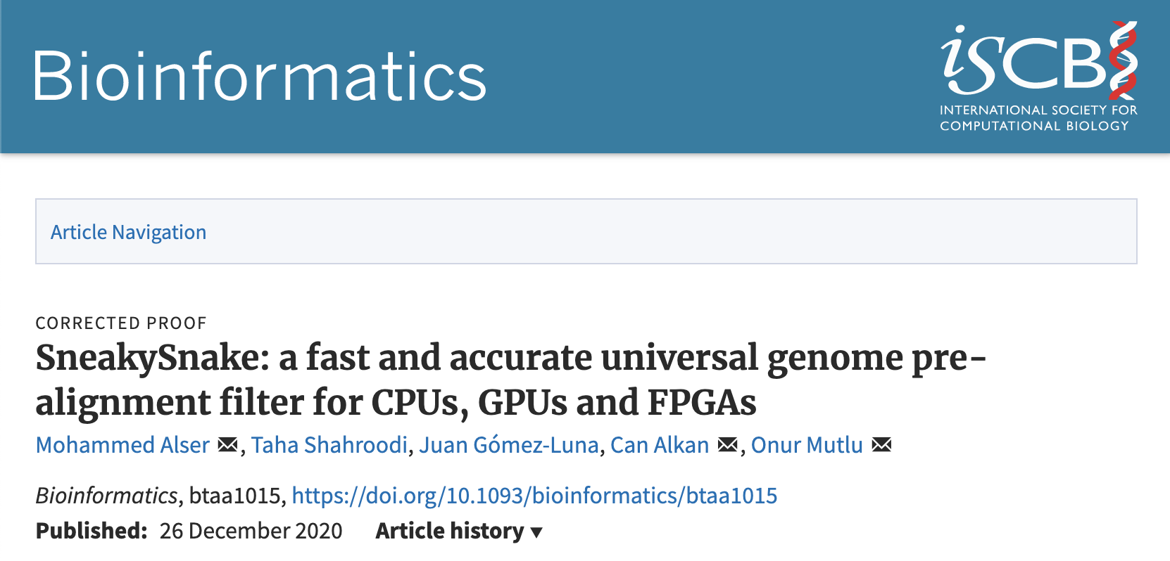
Specialized Hardware for Pre-alignment Filtering
Mohammed Alser, Taha Shahroodi, Juan-Gomez Luna, Can Alkan, and Onur Mutlu, "SneakySnake: A Fast and Accurate Universal Genome Pre-Alignment Filter for CPUs, GPUs, and FPGAs" Bioinformatics, 2020. [Source Code] [Online link at Bioinformatics Journal]

Slide 24
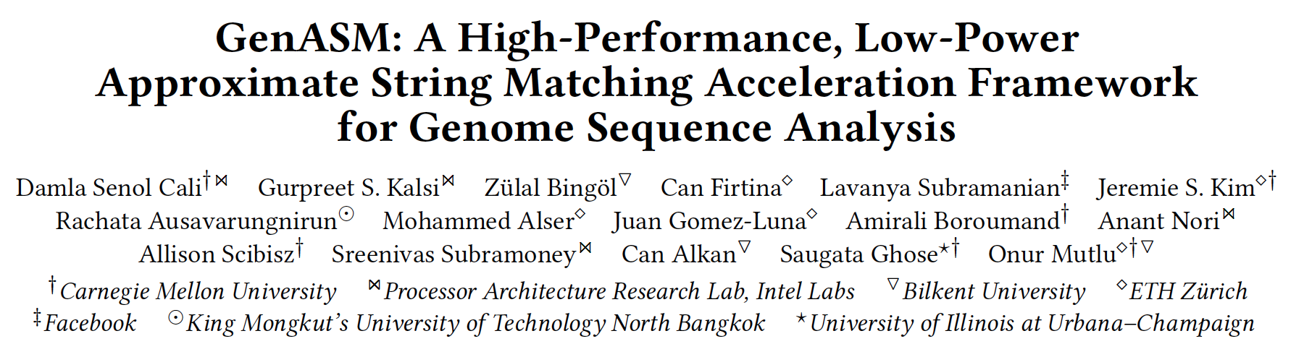
GenASM Framework [MICRO 2020]
Damla Senol Cali, Gurpreet S. Kalsi, Zulal Bingol, Can Firtina, Lavanya Subramanian, Jeremie S. Kim, Rachata Ausavarungnirun, Mohammed Alser, Juan Gomez-Luna, Amirali Boroumand, Anant Nori, Allison Scibisz, Sreenivas Subramoney, Can Alkan, Saugata Ghose, and Onur Mutlu, "GenASM: A High-Performance, Low-Power Approximate String Matching Acceleration Framework for Genome Sequence Analysis" Proceedings of the 53rd International Symposium on Microarchitecture (MICRO), Virtual, October 2020. [Lighting Talk Video (1.5 minutes)] [Lightning Talk Slides (pptx) (pdf)] [Talk Video (18 minutes)] [Slides (pptx) (pdf)]

Slide 25
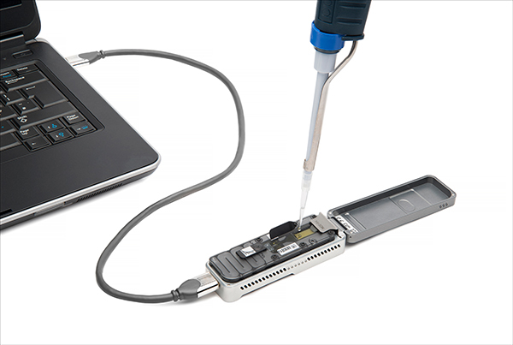
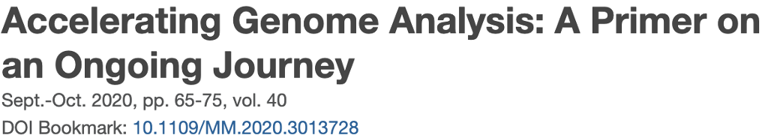
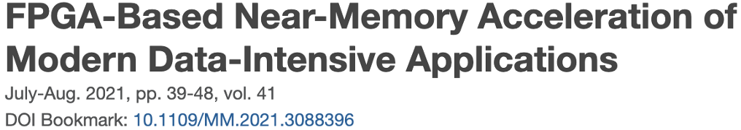
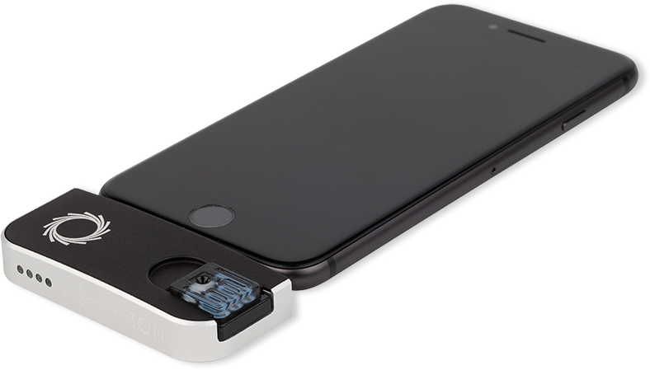
Future of Genome Sequencing & Analysis
Mohammed Alser, Zülal Bingöl, Damla Senol Cali, Jeremie Kim, Saugata Ghose, Can Alkan, Onur Mutlu
“Accelerating Genome Analysis: A Primer on an Ongoing Journey” IEEE Micro, August 2020.
MinION from ONT
SmidgION from ONT

Slide 26
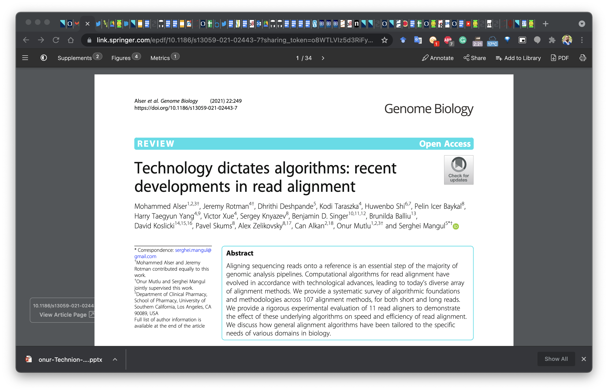
Read Mapping in 111 pages!
In-depth analysis of 107 read mappers (1988-2020)
Mohammed Alser, Jeremy Rotman, Dhrithi Deshpande, Kodi Taraszka, Huwenbo Shi, Pelin Icer Baykal, Harry Taegyun Yang, Victor Xue, Sergey Knyazev, Benjamin D. Singer, Brunilda Balliu, David Koslicki, Pavel Skums, Alex Zelikovsky, Can Alkan, Onur Mutlu, Serghei Mangul
"Technology dictates algorithms: Recent developments in read alignment"
Genome Biology, 2021
[Source code]

Slide 27
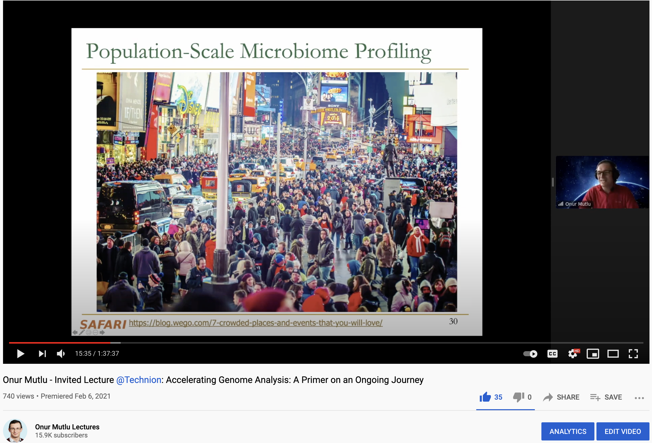
More on Fast & Efficient Genome Analysis …
Onur Mutlu, "Accelerating Genome Analysis: A Primer on an Ongoing Journey" Invited Lecture at Technion, Virtual, 26 January 2021. [Slides (pptx) (pdf)] [Talk Video (1 hour 37 minutes, including Q&A)] [Related Invited Paper (at IEEE Micro, 2020)]
https://www.youtube.com/watch?v=r7sn41lH-4A

Slide 28
Detailed Lectures on Genome Analysis
Computer Architecture, Fall 2020, Lecture 3a
Introduction to Genome Sequence Analysis (ETH Zürich, Fall 2020)
https://www.youtube.com/watch?v=CrRb32v7SJc&list=PL5Q2soXY2Zi9xidyIgBxUz7xRPS-wisBN&index=5
Computer Architecture, Fall 2020, Lecture 8
Intelligent Genome Analysis (ETH Zürich, Fall 2020)
https://www.youtube.com/watch?v=ygmQpdDTL7o&list=PL5Q2soXY2Zi9xidyIgBxUz7xRPS-wisBN&index=14
Computer Architecture, Fall 2020, Lecture 9a
GenASM: Approx. String Matching Accelerator (ETH Zürich, Fall 2020)
https://www.youtube.com/watch?v=XoLpzmN-Pas&list=PL5Q2soXY2Zi9xidyIgBxUz7xRPS-wisBN&index=15
Accelerating Genomics Project Course, Fall 2020, Lecture 1
Accelerating Genomics (ETH Zürich, Fall 2020)
https://www.youtube.com/watch?v=rgjl8ZyLsAg&list=PL5Q2soXY2Zi9E2bBVAgCqLgwiDRQDTyId
https://www.youtube.com/onurmutlulectures

Slide 29
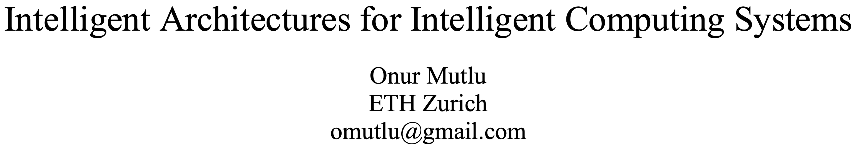
A Blueprint for Fundamentally Better Architectures
Onur Mutlu, "Intelligent Architectures for Intelligent Computing Systems" Invited Paper in Proceedings of the Design, Automation, and Test in Europe Conference (DATE), Virtual, February 2021. [Slides (pptx) (pdf)] [IEDM Tutorial Slides (pptx) (pdf)] [Short DATE Talk Video (11 minutes)] [Longer IEDM Tutorial Video (1 hr 51 minutes)]

Slide 30
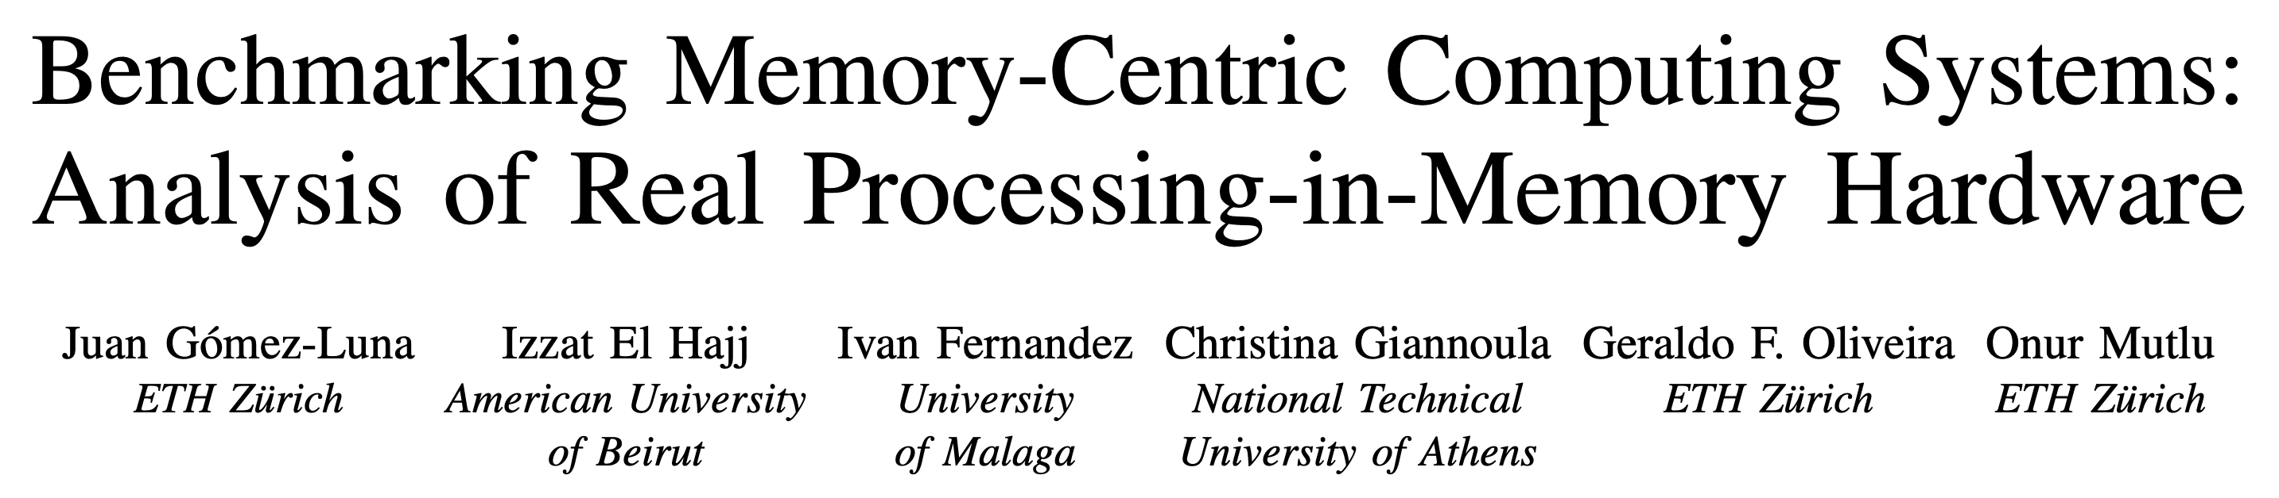
Analysis of first publicly available PIM Architecture
Juan Gomez-Luna, Izzat El Hajj, Ivan Fernandez, Christina Giannoula, Geraldo F. Oliveira, and Onur Mutlu, "Benchmarking Memory-Centric Computing Systems: Analysis of Real Processing-in-Memory Hardware" Invited Paper at Workshop on Computing with Unconventional Technologies (CUT), Virtual, October 2021. [arXiv version] [PrIM Benchmarks Source Code] [Slides (pptx) (pdf)] [Talk Video (37 minutes)] [Lightning Talk Video (3 minutes)]

Slide 31
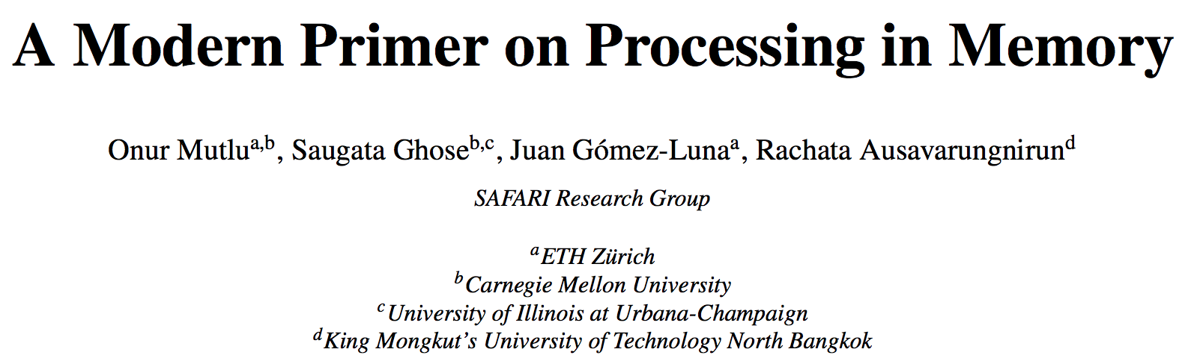
More on Processing in Memory
Onur Mutlu, Saugata Ghose, Juan Gomez-Luna, and Rachata Ausavarungnirun, "A Modern Primer on Processing in Memory" Invited Book Chapter in Emerging Computing: From Devices to Systems - Looking Beyond Moore and Von Neumann, Springer, to be published in 2021.
https://arxiv.org/pdf/1903.03988.pdf

Slide 32
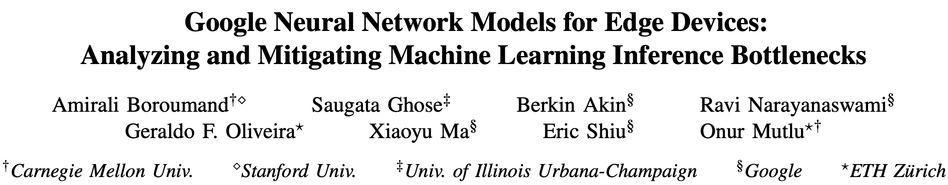
Accelerating Neural Network Inference
Amirali Boroumand, Saugata Ghose, Berkin Akin, Ravi Narayanaswami, Geraldo F. Oliveira, Xiaoyu Ma, Eric Shiu, and Onur Mutlu, "Google Neural Network Models for Edge Devices: Analyzing and Mitigating Machine Learning Inference Bottlenecks" Proceedings of the 30th International Conference on Parallel Architectures and Compilation Techniques (PACT), Virtual, September 2021. [Slides (pptx) (pdf)] [Talk Video (14 minutes)]

Slide 33
We need intelligent algorithms and intelligent architectures
that handle data well

Slide 34
Agenda for Today - Intelligent Algorithms
Apollo
Correcting errors in genome assembly for more accurate genome analysis
AirLift
Avoiding redundant computations when moving from one reference genome to another
BLEND
Using fewer and high-quality seeds for faster, more memory-efficient, and more accurate sequence similarity identification

Slide 35
Agenda for Today - Intelligent Algorithms
Apollo
Correcting errors in genome assembly for more accurate genome analysis
AirLift
Avoiding redundant computations when moving from one reference genome to another
BLEND
Using fewer and high-quality seeds for faster, more memory-efficient, and more accurate sequence similarity identification

Slide 36
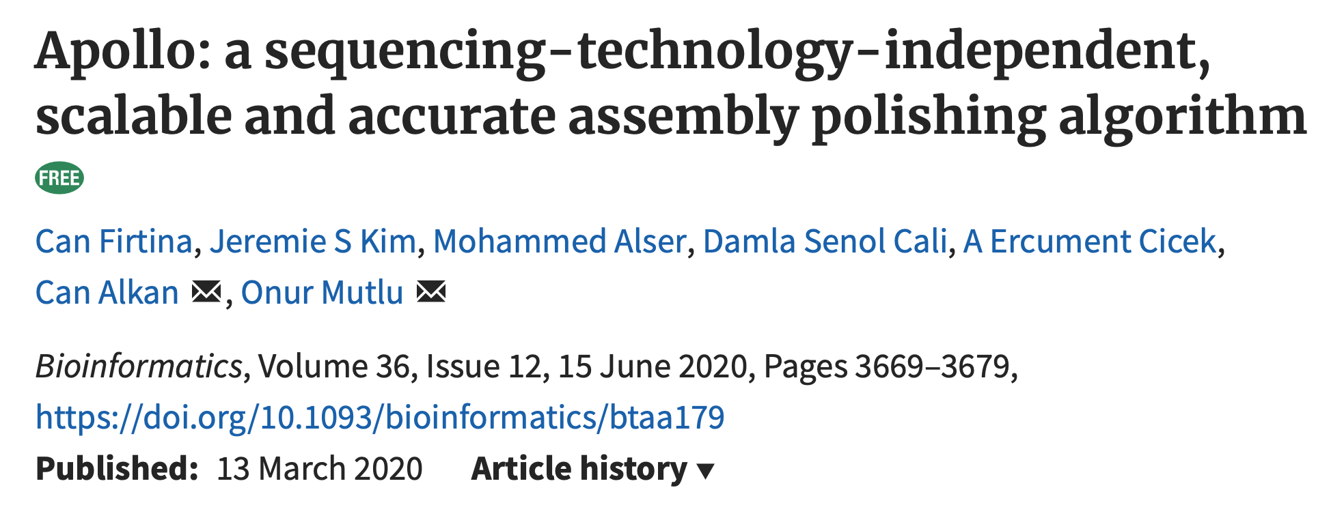
Assembly Polishing using ML
Can Firtina, Jeremie S. Kim, Mohammed Alser, Damla Senol Cali, A. Ercument Cicek, Can Alkan, and Onur Mutlu, "Apollo: A Sequencing-Technology-Independent, Scalable, and Accurate Assembly Polishing Algorithm" Bioinformatics, June 2020. [Source Code] [Online link at Bioinformatics Journal]

Slide 37
Executive Summary
Problem:
Long read de-novo assembly is inherently erroneous
Existing assembly polishing techniques cannot adapt to varying sequencing technologies and do not scale well for large genomes
Goal: Propose a technology-independent and scalable assembly polishing algorithm – Apollo
Key Ideas:
Use a probabilistic graph structure to identify the errors in assemblies accurately
Profile hidden Markov models (pHMMs)
Realign erroneous reads to the pHMM graph of an assembly to correct the errors by updating the probabilities based on a machine learning technique
Results
Apollo is the only assembly polishing that is scalable to polish large genomes given the limited memory constraints (e.g., 192GB)
Apollo constructs the most reliable assemblies when hybrid set of reads (e.g., Illumina and PacBio) are used in a single run compared to other polishing tools
Apollo is ~25x slower on average (up to ~600x) than other polishers

Slide 38
Genome Assembly from Erroneous Reads
Genome
(Non-human-
readable)
Sequencing
Reads
(Human-
readable)
Overlap
Cleaning
Ordering
Sequencing Errors
Erroneous Assembly:

Slide 39
Assembly Polishing with Apollo
Sequencing errors on reads may propagate to contigs
Leading to inaccurate analysis on the assembly we just generated
Idea: Align reads back to contigs again to generate a more accurate consensus with Apollo
Sequencing Errors
Align Reads to Contigs
Erroneous
Assembly:
Aligned Reads:
Apollo
Corrected
Assembly:

Slide 40
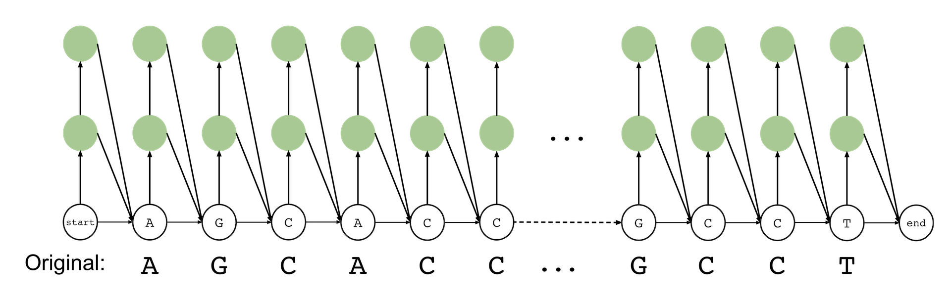
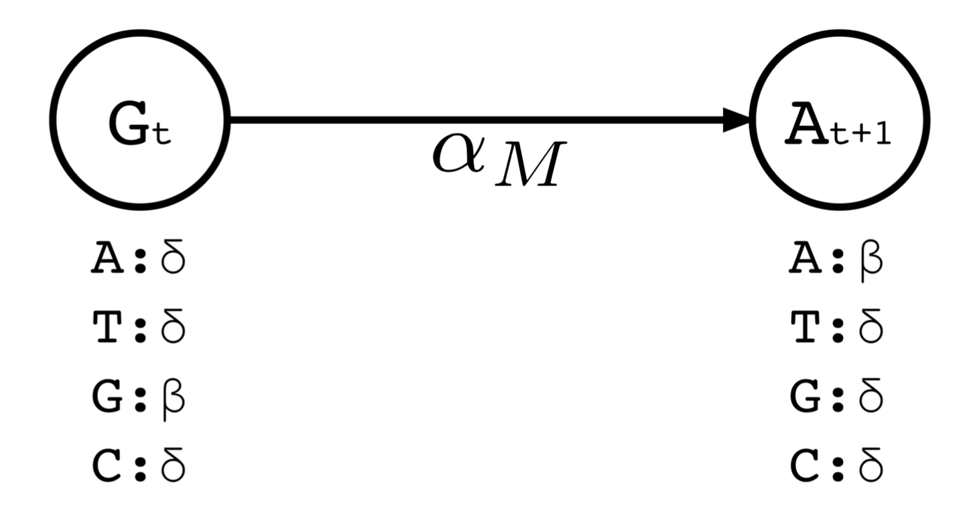
Profile Hidden Markov Models (pHMMs)
A profile hidden Markov
model of the assembly:
AGCACC…GCCT
Three components:
States
Emissions
Transitions (directed edges)
Modification roles and probabilities are assigned to states, transitions, and emissions
Substitution, insertion, deletion, or match (no modification)

Slide 41
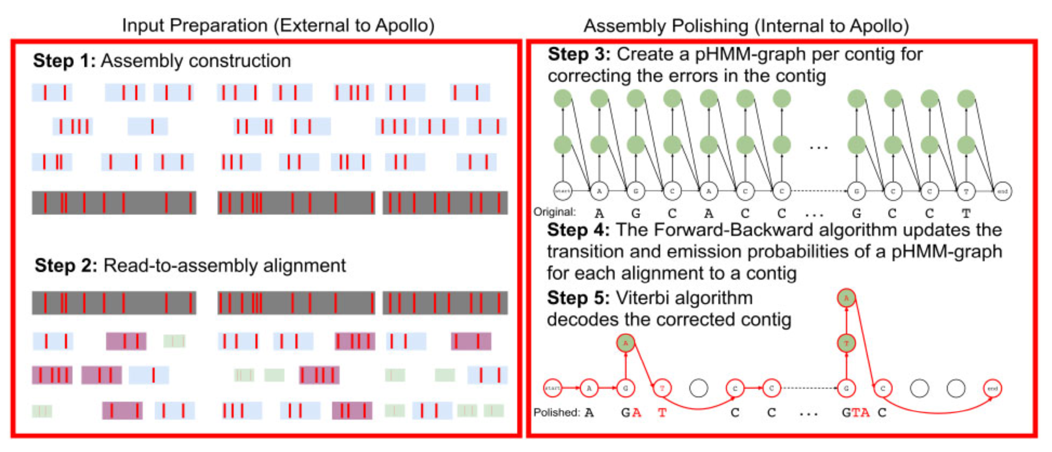
Apollo Workflow
Steps external to Apollo
Step 1: Generate de novo assembly using any assembler
Step 2: Align reads to the de novo assembly of a genome
Steps internal to Apollo
Step 3: Generate a pHMM graph for a genome assembly
Step 4: Update the probabilities of the pHMM graph using the alignment information from step 3
Step 5: Use the updated probabilities in pHMM to decode the corrected version of the genome assembly

Slide 42
Key Results
State-of-the-art polishing tools: Racon, Pilon, Quiver, Nanopolish
Apollo is the only tool that can scale to polish large genomes
Read set: PacBio (35x and 8.9x) and Illumina (22x)
Racon, Pilon and Quiver exceeds memory requirements (192GB) when using high/medium coverage PacBio/Illumina reads
Apollo is the only algorithm that is scalable to polish large contigs given the memory constraints
Apollo generates the most reliable assemblies
Canu assembler rather than Miniasm
Polish using both long and Illumina reads (i.e., hybrid reads)
Apollo to use hybrid reads
It can use multiple read sets in a single run
Apollo performs better than Nanopolish (~2-5x) but worse than Racon, Pilon, and Quiver (up to 600x, on average ~20-25x)

Slide 43
Future Work
Apollo performs worse due to its computationally expensive parameter update (training) and decoding (inference) steps
Both training and inference steps are based on embarrassingly parallel algorithms
CPU cannot utilize all available parallelism
We implemented the training step in GPUs and observe that we can achieve around 45x performance improvement compared to the CPU
Can we do better? Hardware acceleration for training?
Combining training and inference steps in an accelerator would potentially provide even better performance improvements
Parameter optimizations for different sequencing technologies to improve sensitivity

Slide 44
Executive Summary
Problem:
Long read de-novo assembly is inherently erroneous
Existing assembly polishing techniques cannot adapt to varying sequencing technologies and do not scale well for large genomes
Goal: Propose a technology-independent and scalable assembly polishing algorithm – Apollo
Key Ideas:
Use a probabilistic graph structure to identify the errors in assemblies accurately
Profile hidden Markov models (pHMMs)
Realign erroneous reads to the pHMM graph of an assembly to correct the errors by updating the probabilities based on a machine learning technique
Results
Apollo is the only assembly polishing that is scalable to polish large genomes given the limited memory constraints (e.g., 192GB)
Apollo constructs the most reliable assemblies when hybrid set of reads (e.g., Illumina and PacBio) are used in a single run compared to other polishing tools
Apollo is ~25x slower on average (up to ~600x) than other polishers

Slide 45
Assembly Polishing using ML
Can Firtina, Jeremie S. Kim, Mohammed Alser, Damla Senol Cali, A. Ercument Cicek, Can Alkan, and Onur Mutlu, "Apollo: A Sequencing-Technology-Independent, Scalable, and Accurate Assembly Polishing Algorithm" Bioinformatics, June 2020. [Source Code] [Online link at Bioinformatics Journal]

Slide 46
Agenda for Today - Intelligent Algorithms
Apollo
Correcting errors in genome assembly for more accurate genome analysis
AirLift
Avoiding redundant computations when moving from one reference genome to another
BLEND
Using fewer and high-quality seeds for faster, more memory-efficient, and more accurate sequence similarity identification

Slide 47
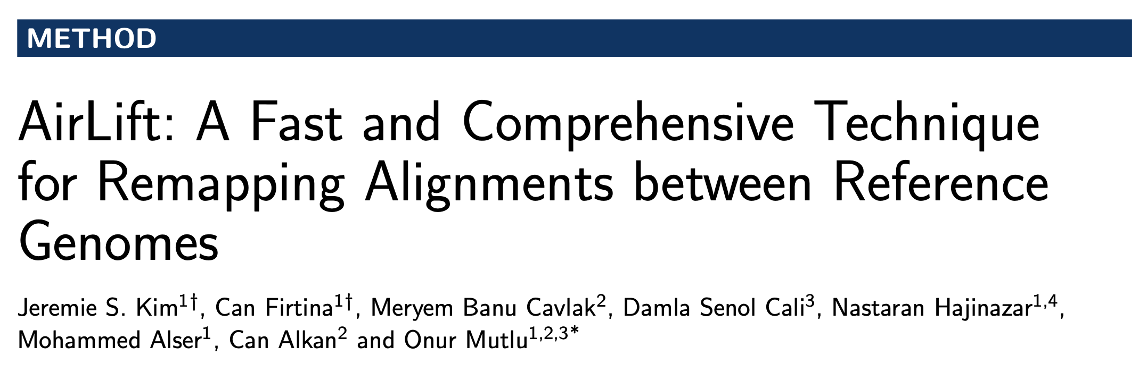
Remapping Alignments Between References
Jeremie S. Kim, Can Firtina, Meryem Banu Cavlak, Damla Senol Cali, Nastaran Hajinazar, Mohammed Alser, Can Alkan, and Onur Mutlu, "AirLift: A Fast and Comprehensive Technique for Remapping Alignments between Reference Genomes" Preprint in arXiv and bioRxiv, 17 February 2021. [bioRxiv preprint] [arXiv preprint] [AirLift Source Code and Data]

Slide 48
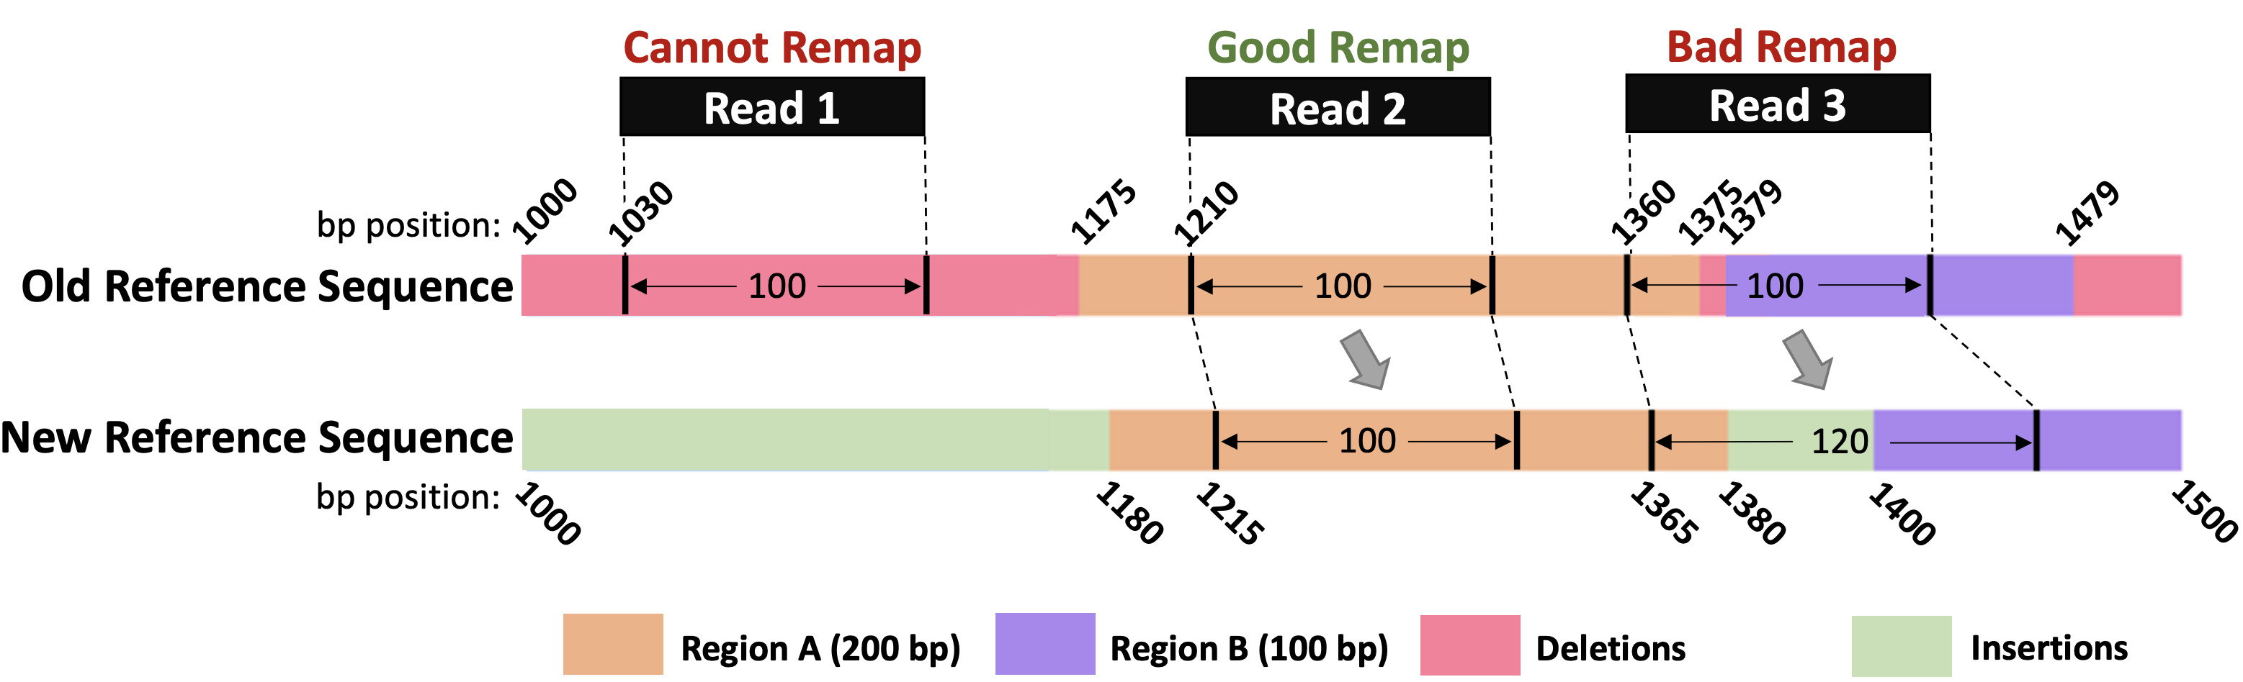
Background
Reference genomes are updated frequently (~quarterly)
For accurate annotations for an updated genome, all reads of a given sample are completely remapped to the new, updated reference genome
This becomes unreasonable with the number of sequenced genomes available now
Currently, existing works speed up this process by only moving annotations (e.g., read mapping positions) given known matching regions

Slide 49
Background (cont’d)
A number of tools exist for remapping annotations
To remap across samples of the same species or across very similar reference genomes
Tools:
UCSC Liftover
CrossMap
RECOT
Segment_liftover
NCBI Genome Remapping Service
Assembly Converter (Ensembl)
Galaxy (based on UCSC liftover)
Pyliftover
Generate Chain files, which indicates similar blocks of regions across two genomes (via global alignment) and move annotations using the chain file

Slide 50
Executive Summary
Problem:
Remapping full set of reads to newer reference genome is accurate, but very computationally costly
Existing tools that move the annotations from one reference to another miss moving large portion of annotations to a new reference genome
Goal: Maintain baseline accuracy of remapping full set of reads, while significantly accelerating the process of moving from one reference to another
Key Ideas:
Categorize and label each region in the old reference genome compared to the new reference genome
Either 1) Remap a read to a new reference genome or 2) simply move its annotation based on the label of the region that the read falls into in the old reference genome
Results
2.6x – 6.7x speedup compared to fully mapping reads, while identifying SNPs and Indels with precision and recall similar to full mapping

Slide 51
Problem
Existing tools move annotations (e.g., read mapping positions) only if the same region appears in the new reference genome
Same regions between two reference genomes are identified using global alignment – chain files contain the aligning blocks
Simply moving annotations, based on a global alignment does not account for a large portion of genes.
We find that from hg19 -> hg38, up to 7% of genes are missed (GENCODE)
Simply moving annotations is not accurate
and it loses a significant amount of information
Potentially important region where annotations are lost

Slide 52
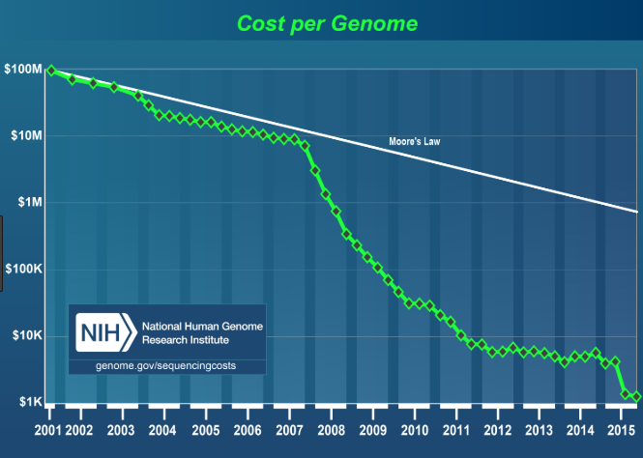
Problem (cont’d)
To reach baseline accuracy of completely read mapping reads to the new reference genome:
Could re-run read mapping to the entire new reference genome
This is expensive especially if we want to map every existing sequenced genome (>500,000 as of 2017) to every reference genome update (quarterly)

Slide 53
Goal
Maintain baseline accuracy of mapping reads to an updated reference genome, while significantly accelerating the process
Baseline is using a full mapper
Enable quick and accurate mapping of every sample to every updated reference genome no matter how small the changes
This will quickly give us the most up to date information about a sample’s genome

Slide 54
Mechanism
We provide a method for quickly remapping all the reads of a sample from one reference genome to an updated version of the reference genome
Read mapping to old reference genome
(SAM/BAM file)
AirLift
Chain file + new reference genome
Updated read mapping to new reference genome
(SAM/BAM file)

Slide 55
Mechanism (cont’d)
We provide a method for quickly remapping all the reads of a sample from one reference genome to an updated version of the reference genome
Reads
Chain files provide the following relationship between two reference genomes

Slide 56
Labeling Regions of Reference Genomes
We quickly label the regions between two reference genomes to decide if we should
Move the read mapping position without performing costly alignment or
Remap reads that maps in the regions that are missing in the new reference genome
Finding labels between a pair of reference genomes is a one-time task: AirLift Index
Labels: Constant, updated, retired, and new regions

Slide 57
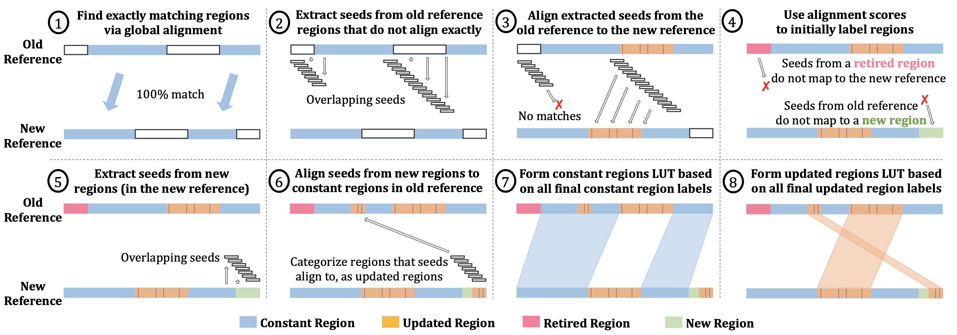
AirLift Index: Labeling Regions in 8 steps

Slide 58
AirLift Index: Labeling Regions in 8 steps

Slide 59
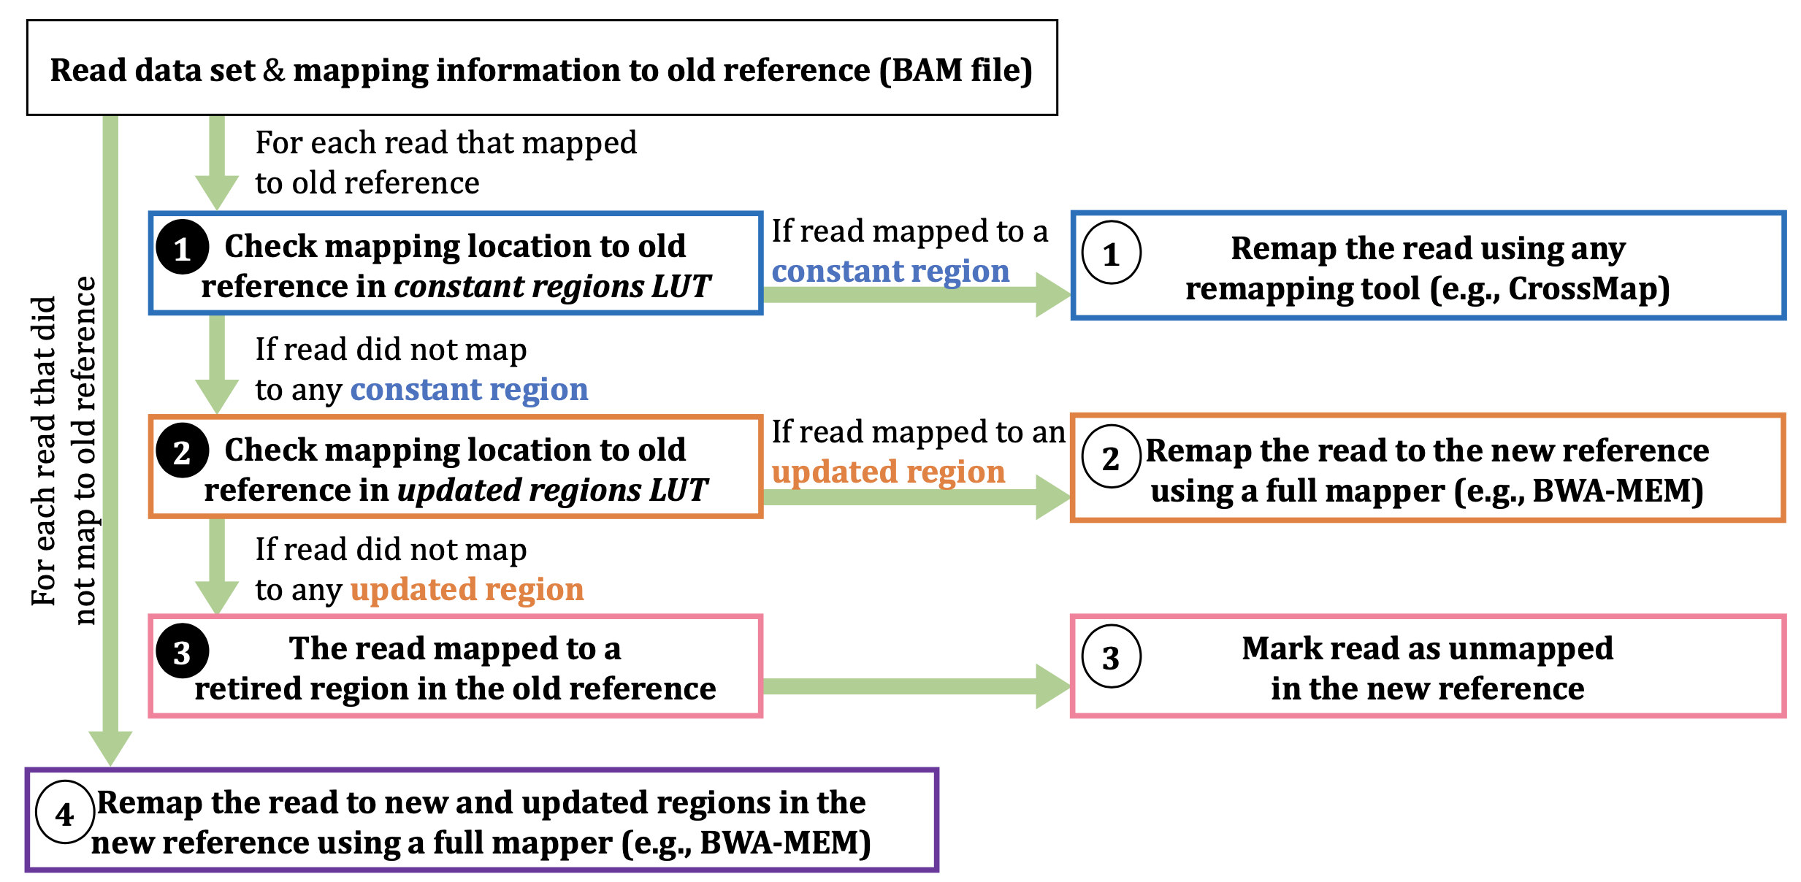
Updating Read Mapping using AirLift Index

Slide 60
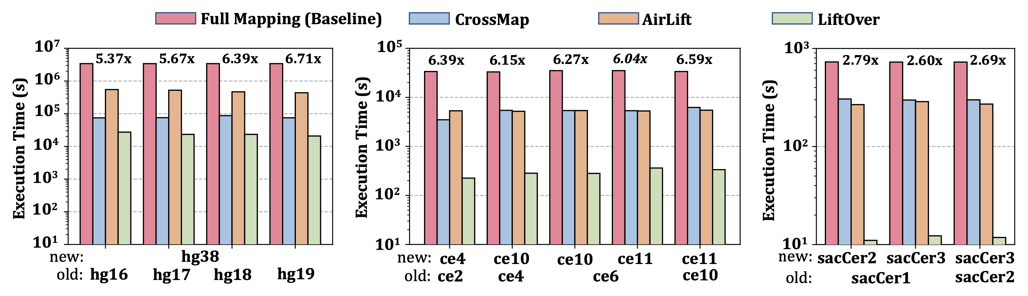
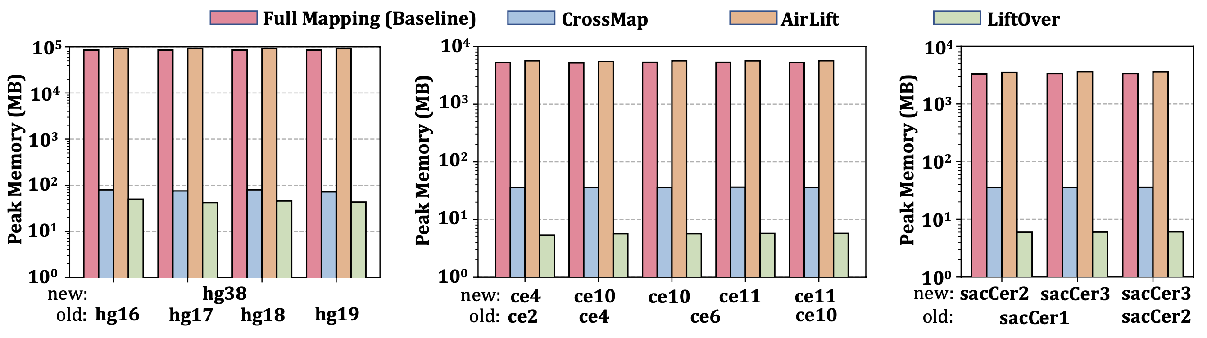
Key Results – Performance and Memory
AirLift is 2.6x-6.71x faster than full mapping while requiring similar peak memory usage

Slide 61
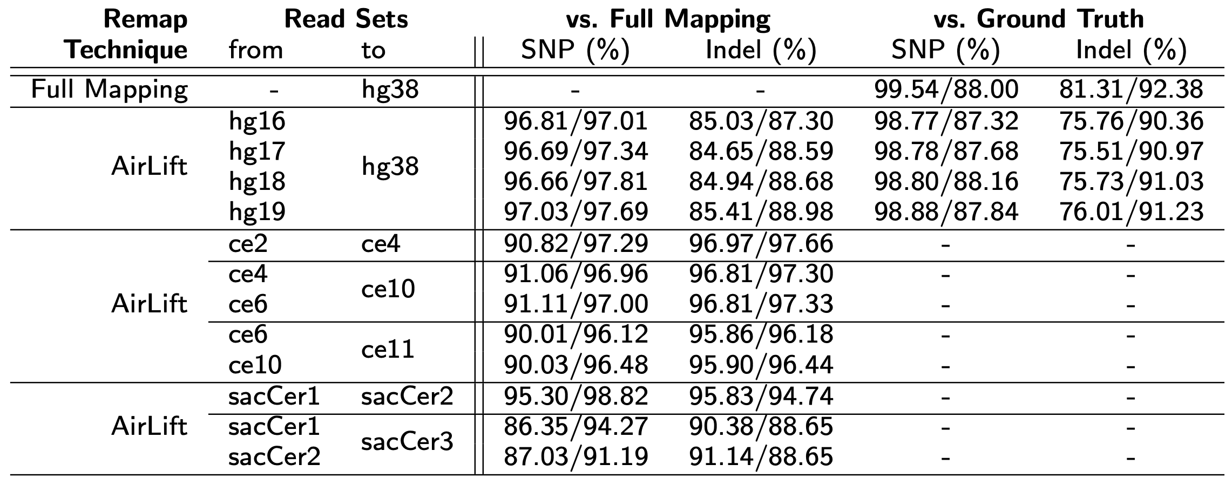
Key Results – Variant Calling
We use GATK to call the variants in read mappings that full mapping (to new reference genome) and AirLift generate
Variant calling ground truth from Platinum Genomes and GIAB for the human NA12878 sample
Variant calling accuracy is comparable to full mapping

Slide 62
Executive Summary
Problem:
Remapping full set of reads to newer reference genome is accurate, but very computationally costly
Existing tools that move the annotations from one reference to another miss moving large portion of annotations to a new reference genome
Goal: Maintain baseline accuracy of remapping full set of reads, while significantly accelerating the process of moving from one reference to another
Key Ideas:
Categorize and label each region in the old reference genome compared to the new reference genome
Either 1) Remap a read to a new reference genome or 2) simply move its annotation based on the label of the region that the read falls into in the old reference genome
Results
2.6x – 6.7x speedup compared to fully mapping reads, while identifying SNPs and Indels with precision and recall similar to full mapping

Slide 63
Remapping Alignments Between References
Jeremie S. Kim, Can Firtina, Meryem Banu Cavlak, Damla Senol Cali, Nastaran Hajinazar, Mohammed Alser, Can Alkan, and Onur Mutlu, "AirLift: A Fast and Comprehensive Technique for Remapping Alignments between Reference Genomes" Preprint in arXiv and bioRxiv, 17 February 2021. [bioRxiv preprint] [arXiv preprint] [AirLift Source Code and Data]

Slide 64
Agenda for Today - Intelligent Algorithms
Apollo
Correcting errors in genome assembly for more accurate genome analysis
AirLift
Avoiding redundant computations when moving from one reference genome to another
BLEND
Using fewer and high-quality seeds for faster, more memory-efficient, and more accurate sequence similarity identification

Slide 65
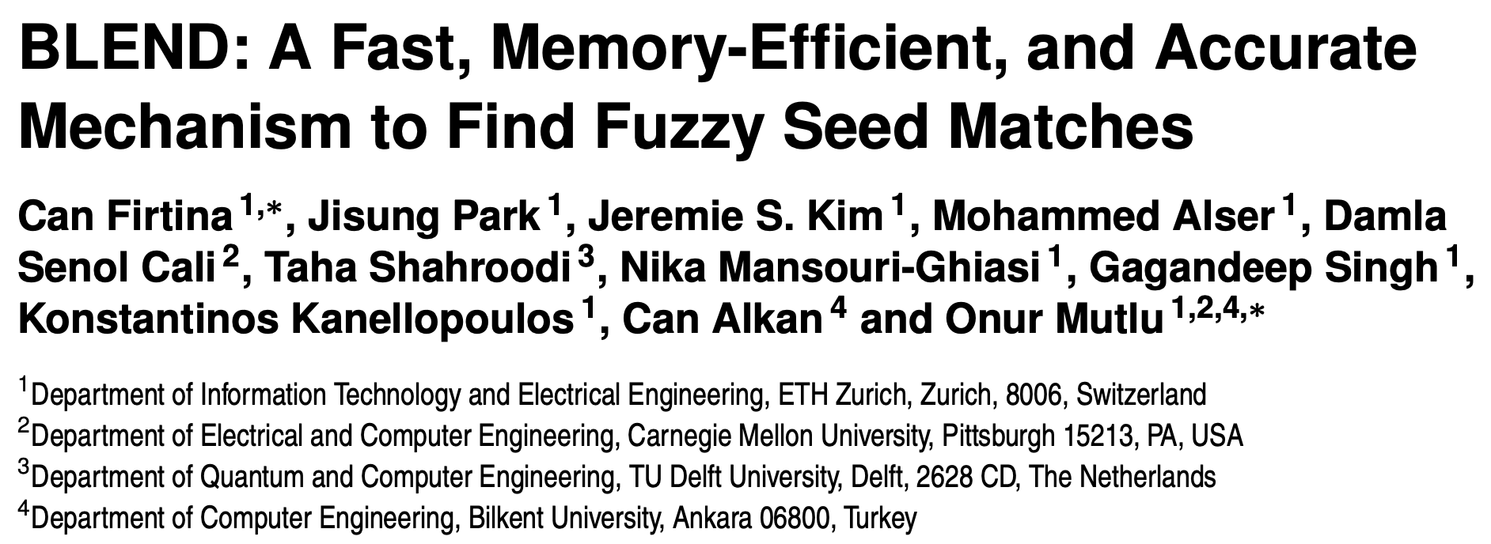
Finding Efficient and Accurate Seed Matches
Can Firtina, Jisung Park, Jeremie S. Kim, Mohammed Alser, Damla Senol Cali, Taha Shahroodi, Nika Mansouri-Ghiasi, Gagandeep Singh, Konstantinos Kanellopoulos, Can Alkan, and Onur Mutlu, "BLEND: A Fast, Memory-Efficient, and Accurate Mechanism to Find Fuzzy Seed Matches" Preprint in arXiv, 16 December 2021. [arXiv preprint] [BLEND Source Code and Data]

Slide 66
Background – Seeds
Seeds: Short subsequences used for matching between sequences (e.g., read and a reference genome)
Seeds enable filtering out large portion of sequence pairs that are unlikely to be similar
Distance calculation (e.g., approximate string matching) is costly
Heuristic: Calculate the distance between a pair of sequences only if they share some amount of seeds
Target Sequence (e.g., Reference Genome)
Query Sequence
(e.g., Read)
Seeds

Slide 67
Background – Matching Seeds
Several ways for finding seed matches:
Building up an index: FM-index, Hash tables…
Calculating similarities between seeds using their k-mer content
Types of seed matches:
Exact-matching seeds:
Faster to find – Relatively low computational cost
Usually very short – many matches
Approximate (fuzzy) seed matches:
More costly to find
Can be more selective in seed matches

Slide 68
Executive Summary
Problem: Existing seed matching techniques suffer from performing either
Too many costly approximate string matching due to finding a large number of exact-matching seeds
Costly similarity calculations to find fewer fuzzy seed matches
Goal: Quickly and efficiently find fuzzy seed matches between sequences to improve the performance, memory efficiency, and accuracy of the applications that use seeds
Key Ideas:
Generate the same hash value for highly similar seeds using a hashing technique called SimHash
A single hash value for a seed to find fuzzy seed matches, unlike other works that use many hash values
The same hash value for highly similar seeds even though these seeds may mismatch at any arbitrary position, unlike spaced seeding
Build and use the hash table using these hash values that BLEND generates
Key Results
For finding overlapping reads, on average, 8.6x speedup and 5.43x lower memory footprint compared to the state-of-the-art, Minimap2
We can construct more accurate and contiguous assemblies using the overlapping reads that BLEND finds compared to using the ones Minimap2 finds

Slide 69
High-Level Overview of BLEND
We find fuzzy seed matches between two sets of sequences
Target sequences (e.g., a reference genome)
Query sequences (e.g., read sequences)
BLEND can generate the same single hash value for similar seeds
Using BLEND, we generate the hash values of all the seeds of all target sequences and store them in a hash table
Enables efficient lookup of these hash values
BLEND generates the hash value for each seed in query sequences and queries the hash table with these hash values
Enables finding fuzzy seed matches if the same hash value exist in the hash table

Slide 70
Building the Hash Table – Step 1
Select (some) k-mers of a target sequence
We can reduce the storage requirements per sequence by just storing the few k-mers, not all, with minimal information loss (i.e., minimizer k-mers)
Roberts, Michael +, “Reducing Storage Requirements for Biological Sequence Comparison,” Bioinformatics, 2004.

Slide 71
Building the Hash Table – Step 2
Generate seeds around each selected k-mer
We use seeds because we want to avoid searching the entire sequence
We identify the sites to use as seeds around the selected k-mers because we want to use as few seeds as possible for a sequence (low computational and space overhead)

Slide 72
Building the Hash Table – Step 3
Generate the hash values of seeds using SimHash
To enable efficient comparisons of equivalence or high similarity between seeds
Charikar, Moses S. “Similarity Estimation Techniques from Rounding Algorithms.” STOC, 2002. New York, NY, USA

Slide 73
Building the Hash Table – Step 4
Use the hash table to store
Hash values as keys
List of seeds that have the same hash value in the target sequence

Slide 74
Overview of all the Steps

Slide 75
Querying the Hash Table
For each query sequence (e.g., a read sequence), apply the same steps 1-3 to generate the seeds and their hash values
Use the hash table that BLEND builds for the target sequence to find matching hash values
Between target and query sequences
Matching hash values: List of fuzzy seed matches
BLEND can assign the same hash value for similar seeds

Slide 76
Evaluation Methodology
We integrate the BLEND mechanism into Minimap2 so that it can find fuzzy seed matches when performing end-to-end 1) finding overlapping reads and 2) read mapping
Real and simulated datasets
Real accurate and long reads (HiFi): Human, D. ananassae (fruit fly), and E. coli (bacteria) genomes
Simulated erroneous long reads (PacBio CLR): Yeast genome
Real Illumina paired-end short reads: Yeast genome
Use Cases
Finding overlapping reads
Read mapping

Slide 77
Finding Overlapping Reads -- Performance
Observation 1:
Speedup by 8.6x, 113.48x, and 207.75x, on average
Lower memory footprint by 5.43, 139.48x, and 3.3x
Compared to Minimap2, MHAP, and BLASR, respectively

Slide 78
Finding Overlapping Reads -- Performance
Observation 2: when considering only HiFi reads
Speedup by 11.16x, 143.9x, and 259x, on average
Lower memory footprint by 6.63x, 175.53x, 4.8x, on average
Compared to Minimap2, MHAP, and BLASR, respectively

Slide 79
Finding Overlapping Reads -- Performance
Observation 3: BLEND requires less than 16GB of memory in all cases, making it largely possible to perform finding overlapping reads even in personal computers
Observation 4: BLEND is not as efficient when using erroneous PacBio CLR reads

Slide 80
Finding Overlapping Reads – Overlap Statistics
Observation 1: BLEND usually finds longer overlaps between reads than most tools in all cases
Observation 2: BLEND uses much fewer seeds to find these longer overlaps

Slide 81
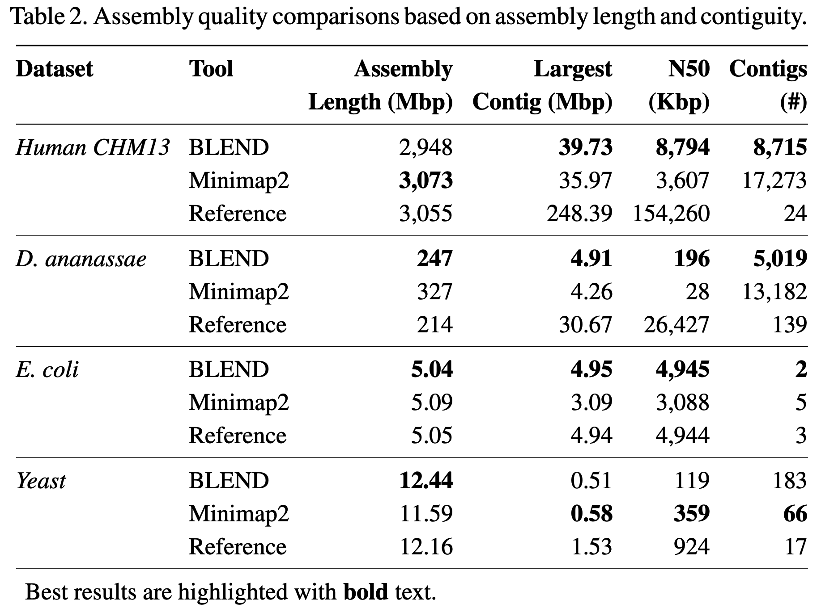
Finding Overlapping Reads – Quality
More contiguous assemblies as BLEND can find long overlaps

Slide 82
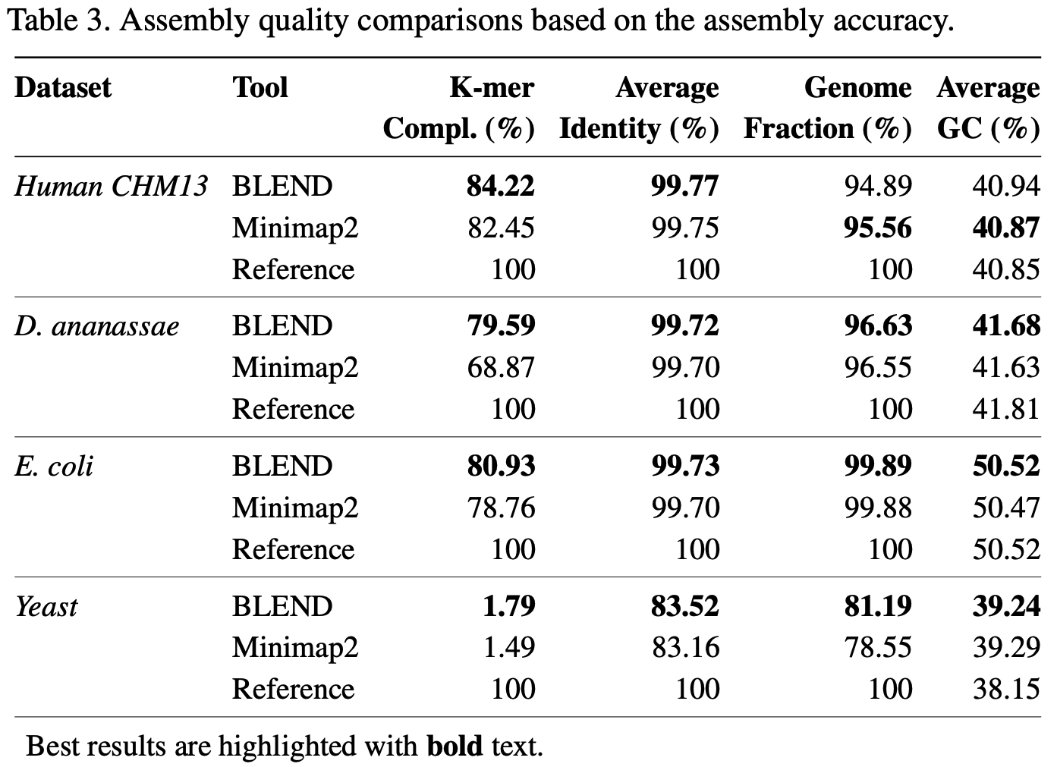
Finding Overlapping Reads – Accuracy
More accurate assemblies as BLEND can fill the missing information by using unique fuzzy seed matches

Slide 83
Conclusion
BLEND can find fuzzy seed matches efficiently to improve the performance, memory efficiency, and accuracy
Significant speedups and lower memory footprint especially when using HiFi reads
We can increase the window length without reducing the accuracy thanks to finding unique fuzzy seed matches that Minimap2 cannot find
BLEND finds longer overlapping regions between sequences while using fewer seeds to find these overlaps

Slide 84
Executive Summary
Problem: Using seed matches between sequences lead to
Too many costly chaining and alignment operations due to many short exact-matching seeds
Finding fuzzy seed matches impose high performance and memory space overheads
Goal: Quickly and efficiently find fuzzy seed matches between sequences to improve the performance, memory efficiency, and accuracy of the applications that use seeds
Key Ideas:
Generate the same hash value for highly similar seeds using a hashing technique called SimHash
A single hash value for a seed to find fuzzy seed matches, unlike other works that use many hash values
The same hash value for highly similar seeds even though these seeds may mismatch at any arbitrary position, unlike spaced seeding
Build and use the hash table using these hash values that BLEND generates
Key Results
For finding overlapping reads, on average, 8.6x speedup and 5.43x lower memory footprint compared to the state-of-the-art, Minimap2
We can construct more accurate and contiguous assemblies using the overlapping reads that BLEND finds compared to using the ones Minimap2 finds

Slide 85
Finding Efficient and Accurate Seed Matches
Can Firtina, Jisung Park, Jeremie S. Kim, Mohammed Alser, Damla Senol Cali, Taha Shahroodi, Nika Mansouri-Ghiasi, Gagandeep Singh, Konstantinos Kanellopoulos, Can Alkan, and Onur Mutlu, "BLEND: A Fast, Memory-Efficient, and Accurate Mechanism to Find Fuzzy Seed Matches" Preprint in arXiv, 16 December 2021. [arXiv preprint] [BLEND Source Code and Data]

Slide 86
Prior Research on Genome Analysis (1/2)
Firtina +, "BLEND: A Fast, Memory-Efficient, and Accurate Mechanism to Find Fuzzy Seed Matches”, arXiv, 2021.
Alser +, "SneakySnake: A Fast and Accurate Universal Genome Pre-Alignment Filter for CPUs, GPUs, and FPGAs." to appear in Bioinformatics, 2020.
Senol Cali+, "GenASM: A High-Performance, Low-Power Approximate String Matching Acceleration Framework for Genome Sequence Analysis", MICRO 2020.
Alser+, "Technology dictates algorithms: Recent developments in read alignment", to appear in Genome Biology, 2021.
Kim+, "AirLift: A Fast and Comprehensive Technique for Translating Alignments between Reference Genomes", arXiv, 2020
Alser+, “Accelerating Genome Analysis: A Primer on an Ongoing Journey”, IEEE Micro, 2020.

Slide 87
Prior Research on Genome Analysis (2/2)
Firtina+, “Apollo: a sequencing-technology-independent, scalable and accurate assembly polishing algorithm”, Bioinformatics, 2020.
Alser+, “Shouji: a fast and efficient pre-alignment filter for sequence alignment”, Bioinformatics 2019.
Kim+, "GRIM-Filter: Fast Seed Location Filtering in DNA Read Mapping Using Processing-in-Memory Technologies”, BMC Genomics, 2018.
Alser+, "GateKeeper: A New Hardware Architecture for Accelerating Pre-Alignment in DNA Short Read Mapping”, Bioinformatics, 2017.
Alser+, "MAGNET: understanding and improving the accuracy of genome pre-alignment filtering”, IPSI Transaction, 2017.

Slide 88
Enabling Accurate, Fast, and Memory-Efficient Genome Analysis via Efficient and Intelligent Algorithms
Can Firtina
canfirtina@gmail.com
10 January 2022
METU Graduate Seminar in Bioinformatics

Slide 89
Backup Slides
89

Slide 90
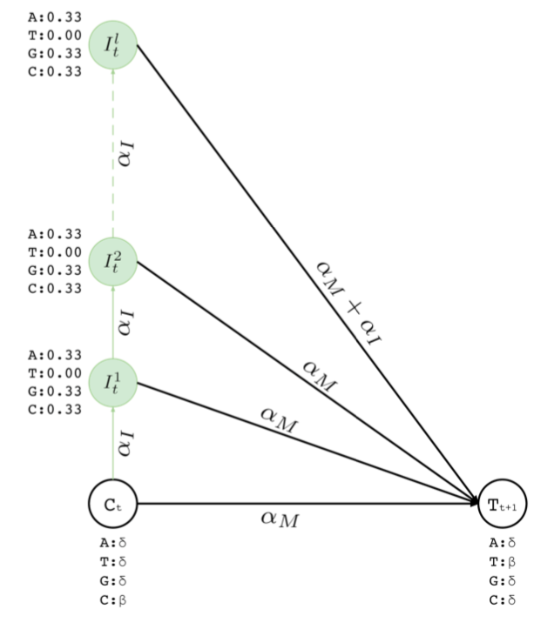
Resolving deletion errors
Insertion states to insert at most l many bases between two bases in a contig
To insert “GC” between ”CT”
Visit match state at position t and emit C
Visit first insertion state after position t and emit G with deletion error probability
Visit second insertion state and emit C with deletion error probability
From second insertion state visit match state at position t+1 and emit T
Resulting sequence “CGCT”
Maximum number of insertions is a parameter to Apollo

Slide 91
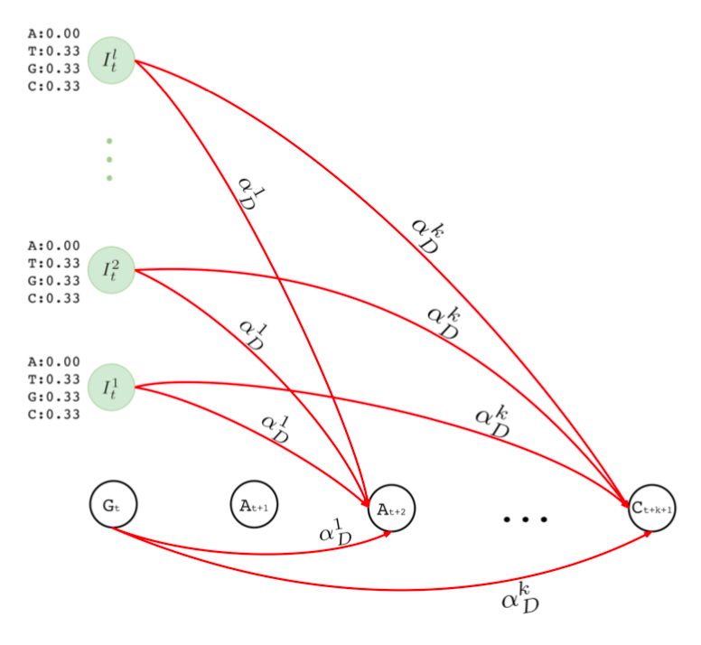
Resolving insertion errors
Deletion transitions to delete one or many bases in a row
To delete the first A in “GAA”
Visit match state at position t and emit G
Visit match state at position t+2 and emit A with single insertion error probability
Resulting sequence: “GA”
Having single or more deletions in a row may not be necessarily equally likely
Maximum number of deletions in a row is a parameter to Apollo

Slide 92
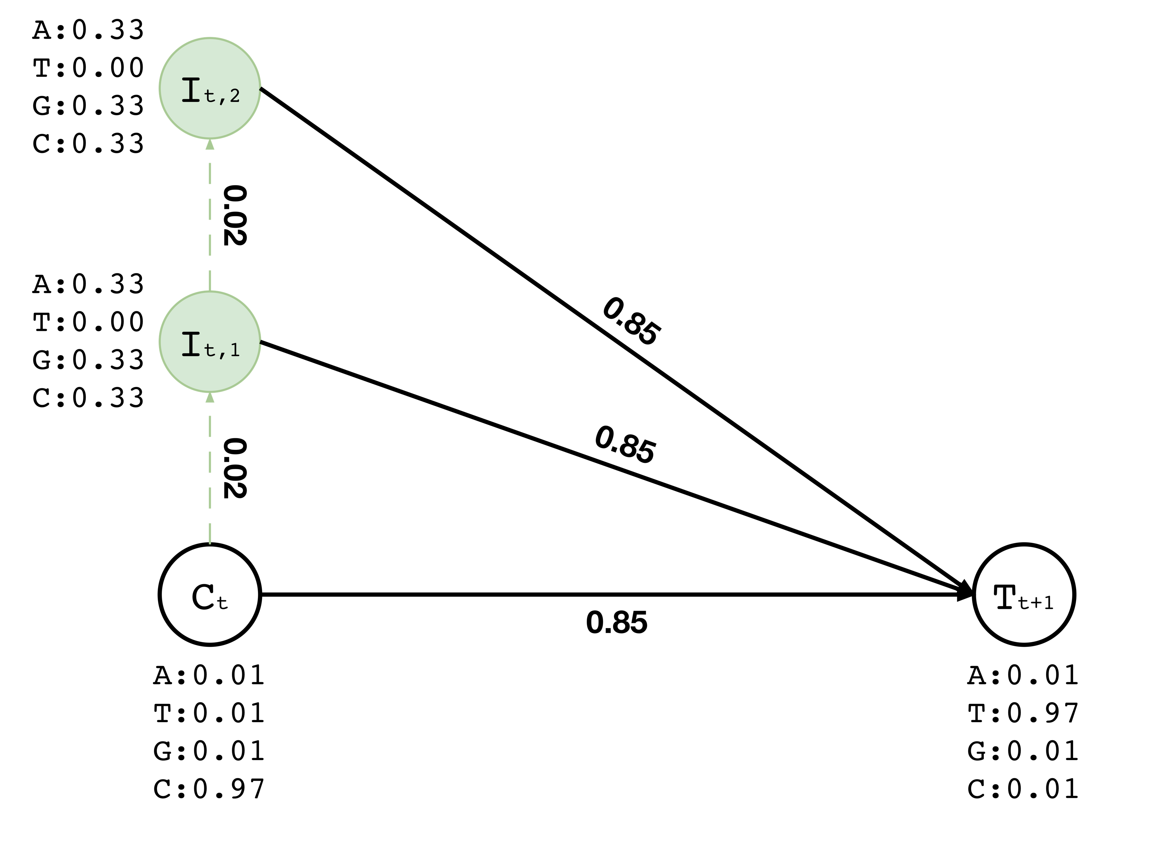
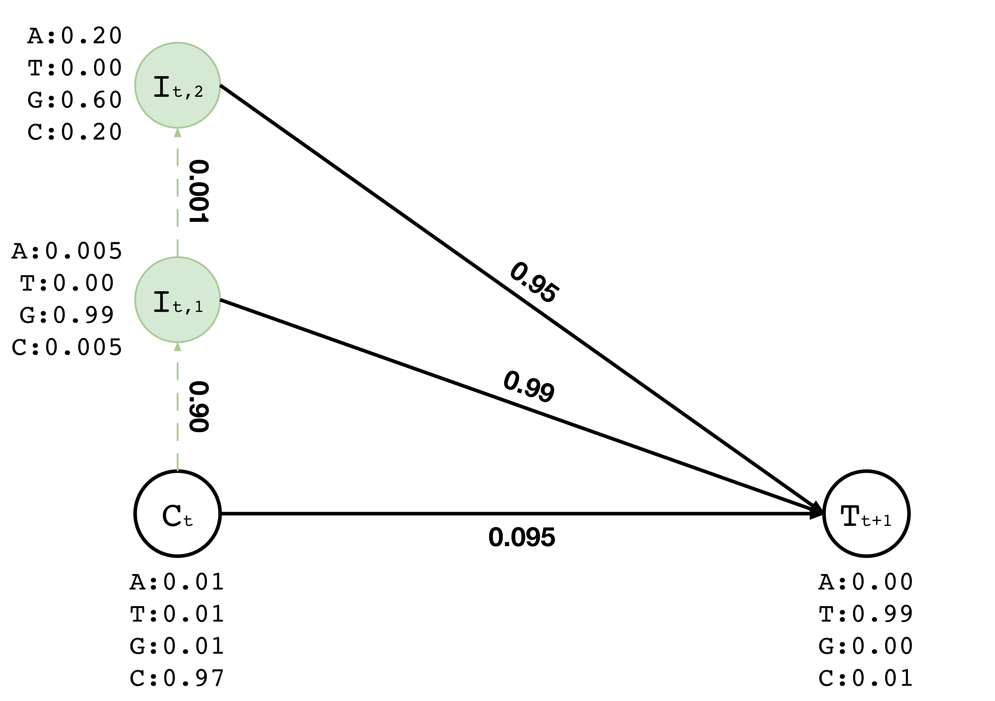

Training
Training data:
Read aligned to the location t of a contig
Assume we have the read “CGT” aligned to location t
After training the corresponding region of the graph we would expect change in the probabilities so that it will be likely to emit “CGT” somehow
CGT

Slide 93
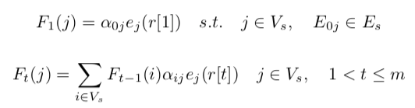

The Forward-Backward algorithm
Calculating the likelihood of visiting a state to emit a certain character of a given sequence (i.e., aligned read)
Forward calculation (F)
Backward calculation (B)
Backward calculation needs a starting point

Slide 94

Training: The Baum-Welch algorithm
Expectation maximization step using the Baum-Welch algorithm
If there are multiple reads aligning to same region, we have multiple F(i) for a position t
Take the average and use it as F(i) for position t

Slide 95

Inference: The Viterbi algorithm
Our original contig before polishing was: “AGCACC…GCCT”
After updating the probabilities, the most likely path from start to end reveals the corrected contig: “AGATCC…GTAC”

Slide 96

Data Sets

Slide 97
Experimental Setup
CPU: Intel®Xeon®Gold 5118 CPU @ 2.30GHz
24 cores (2 threads per core)
Max memory: 192GB
Assigned 45 threads to all tools
Apollo was compared with the state-of-the-art polishing tools
Racon, Pilon, Quiver, Nanopolish

Slide 98
Read Mapping -- Performance
BLEND is mainly effective when using HiFi reads
Speedup and memory efficiency is usually lower than what we observe from finding overlapping reads
We take an additional computationally costly step in read mapping that hinders the benefits of BLEND
Read alignment

Slide 99

Read Mapping – Accuracy
BLEND maps more reads to their correct chromosomes (better precision)
S-conLSH provides the worst accuracy as the precision and the average distance to true position is always the lowest compared to others

Slide 100

Read Mapping – Quality
BLEND usually provides similar quality to Minimap2
Winnowmap usually provides the best quality when using HiFi reads

Slide 101
Readings, Videos, Reference Materials

Slide 102
Research & Teaching: Some Overview Talks
https://www.youtube.com/onurmutlulectures
Future Computing Architectures
https://www.youtube.com/watch?v=kgiZlSOcGFM&list=PL5Q2soXY2Zi8D_5MGV6EnXEJHnV2YFBJl&index=1
Enabling In-Memory Computation
https://www.youtube.com/watch?v=njX_14584Jw&list=PL5Q2soXY2Zi8D_5MGV6EnXEJHnV2YFBJl&index=16
Accelerating Genome Analysis
https://www.youtube.com/watch?v=r7sn41lH-4A&list=PL5Q2soXY2Zi8D_5MGV6EnXEJHnV2YFBJl&index=41
Rethinking Memory System Design
https://www.youtube.com/watch?v=F7xZLNMIY1E&list=PL5Q2soXY2Zi8D_5MGV6EnXEJHnV2YFBJl&index=3
Intelligent Architectures for Intelligent Machines
https://www.youtube.com/watch?v=c6_LgzuNdkw&list=PL5Q2soXY2Zi8D_5MGV6EnXEJHnV2YFBJl&index=25
The Story of RowHammer
https://www.youtube.com/watch?v=sgd7PHQQ1AI&list=PL5Q2soXY2Zi8D_5MGV6EnXEJHnV2YFBJl&index=39

Slide 103
Accelerated Memory Course (~6.5 hours)
ACACES 2018
Memory Systems and Memory-Centric Computing Systems
Taught by Onur Mutlu July 9-13, 2018
~6.5 hours of lectures
Website for the Course including Videos, Slides, Papers
https://people.inf.ethz.ch/omutlu/acaces2018.html
https://www.youtube.com/playlist?list=PL5Q2soXY2Zi-HXxomthrpDpMJm05P6J9x
All Papers are at:
https://people.inf.ethz.ch/omutlu/projects.htm
Final lecture notes and readings (for all topics)

Slide 104
Longer Memory Course (~18 hours)
TU Wien 2019
Memory Systems and Memory-Centric Computing Systems
Taught by Onur Mutlu June 12-19, 2019
~18 hours of lectures
Website for the Course including Videos, Slides, Papers
https://safari.ethz.ch/memory_systems/TUWien2019
https://www.youtube.com/playlist?list=PL5Q2soXY2Zi_gntM55VoMlKlw7YrXOhbl
All Papers are at:
https://people.inf.ethz.ch/omutlu/projects.htm
Final lecture notes and readings (for all topics)

Slide 105
An Interview on Research and Education
Computing Research and Education (@ ISCA 2019)
https://www.youtube.com/watch?v=8ffSEKZhmvo&list=PL5Q2soXY2Zi_4oP9LdL3cc8G6NIjD2Ydz
Maurice Wilkes Award Speech (10 minutes)
https://www.youtube.com/watch?v=tcQ3zZ3JpuA&list=PL5Q2soXY2Zi8D_5MGV6EnXEJHnV2YFBJl&index=15

Slide 106
More Thoughts and Suggestions
Onur Mutlu, "Some Reflections (on DRAM)" Award Speech for ACM SIGARCH Maurice Wilkes Award, at the ISCA Awards Ceremony, Phoenix, AZ, USA, 25 June 2019. [Slides (pptx) (pdf)] [Video of Award Acceptance Speech (Youtube; 10 minutes) (Youku; 13 minutes)] [Video of Interview after Award Acceptance (Youtube; 1 hour 6 minutes) (Youku; 1 hour 6 minutes)] [News Article on "ACM SIGARCH Maurice Wilkes Award goes to Prof. Onur Mutlu"]
Onur Mutlu, "How to Build an Impactful Research Group" 57th Design Automation Conference Early Career Workshop (DAC), Virtual, 19 July 2020. [Slides (pptx) (pdf)]

Slide 107
Reference Overview Paper
Onur Mutlu, Saugata Ghose, Juan Gomez-Luna, and Rachata Ausavarungnirun, "A Modern Primer on Processing in Memory" Invited Book Chapter in Emerging Computing: From Devices to Systems - Looking Beyond Moore and Von Neumann, Springer, to be published in 2021.
https://arxiv.org/pdf/1903.03988.pdf

Slide 108

Reference Overview Paper I
Onur Mutlu, Saugata Ghose, Juan Gomez-Luna, and Rachata Ausavarungnirun, "Processing Data Where It Makes Sense: Enabling In-Memory Computation" Invited paper in Microprocessors and Microsystems (MICPRO), June 2019. [arXiv version]
https://arxiv.org/pdf/1903.03988.pdf

Slide 109

Reference Overview Paper II
Saugata Ghose, Amirali Boroumand, Jeremie S. Kim, Juan Gomez-Luna, and Onur Mutlu, "Processing-in-Memory: A Workload-Driven Perspective" Invited Article in IBM Journal of Research & Development, Special Issue on Hardware for Artificial Intelligence, to appear in November 2019. [Preliminary arXiv version]
https://arxiv.org/pdf/1907.12947.pdf

Slide 110

Reference Overview Paper III
Saugata Ghose, Kevin Hsieh, Amirali Boroumand, Rachata Ausavarungnirun, Onur Mutlu, "Enabling the Adoption of Processing-in-Memory: Challenges, Mechanisms, Future Research Directions" Invited Book Chapter, to appear in 2018. [Preliminary arxiv.org version]
https://arxiv.org/pdf/1802.00320.pdf

Slide 111

Reference Overview Paper IV
Onur Mutlu and Lavanya Subramanian, "Research Problems and Opportunities in Memory Systems" Invited Article in Supercomputing Frontiers and Innovations (SUPERFRI), 2014/2015.
https://people.inf.ethz.ch/omutlu/pub/memory-systems-research_superfri14.pdf

Slide 112

Reference Overview Paper V
Onur Mutlu, "The RowHammer Problem and Other Issues We May Face as Memory Becomes Denser" Invited Paper in Proceedings of the Design, Automation, and Test in Europe Conference (DATE), Lausanne, Switzerland, March 2017. [Slides (pptx) (pdf)]
https://people.inf.ethz.ch/omutlu/pub/rowhammer-and-other-memory-issues_date17.pdf

Slide 113

Reference Overview Paper VI
Onur Mutlu, "Memory Scaling: A Systems Architecture Perspective" Technical talk at MemCon 2013 (MEMCON), Santa Clara, CA, August 2013. [Slides (pptx) (pdf)] [Video] [Coverage on StorageSearch]
https://people.inf.ethz.ch/omutlu/pub/memory-scaling_memcon13.pdf

Slide 114

Reference Overview Paper VII
Proceedings of the IEEE, Sept. 2017
https://arxiv.org/pdf/1706.08642

Slide 115

Reference Overview Paper VIII
Onur Mutlu and Jeremie Kim, "RowHammer: A Retrospective" IEEE Transactions on Computer-Aided Design of Integrated Circuits and Systems (TCAD) Special Issue on Top Picks in Hardware and Embedded Security, 2019. [Preliminary arXiv version] [Slides from COSADE 2019 (pptx)] [Slides from VLSI-SOC 2020 (pptx) (pdf)] [Talk Video (30 minutes)]

Slide 116
Related Videos and Course Materials (I)
Undergraduate Digital Design & Computer Architecture Course Lecture Videos (2020, 2019, 2018, 2017, 2015, 2014, 2013)
Undergraduate Digital Design & Computer Architecture Course Materials (2020, 2019, 2018, 2015, 2014, 2013)
Graduate Computer Architecture Course Lecture Videos (2019, 2018, 2017, 2015, 2013)
Graduate Computer Architecture Course Materials (2019, 2018, 2017, 2015, 2013)
Parallel Computer Architecture Course Materials (Lecture Videos)

Slide 117
Related Videos and Course Materials (II)
Seminar in Computer Architecture Course Lecture Videos (Spring 2020, Fall 2019, Spring 2019, 2018)
Seminar in Computer Architecture Course Materials (Spring 2020, Fall 2019, Spring 2019, 2018)
Memory Systems Course Lecture Videos (Sept 2019, July 2019, June 2019, October 2018)
Memory Systems Short Course Lecture Materials (Sept 2019, July 2019, June 2019, October 2018)
ACACES Summer School Memory Systems Course Lecture Videos (2018, 2013)
ACACES Summer School Memory Systems Course Materials (2018, 2013)

Slide 118
Some Open Source Tools (I)
Rowhammer – Program to Induce RowHammer Errors
https://github.com/CMU-SAFARI/rowhammer
Ramulator – Fast and Extensible DRAM Simulator
https://github.com/CMU-SAFARI/ramulator
MemSim – Simple Memory Simulator
https://github.com/CMU-SAFARI/memsim
NOCulator – Flexible Network-on-Chip Simulator
https://github.com/CMU-SAFARI/NOCulator
SoftMC – FPGA-Based DRAM Testing Infrastructure
https://github.com/CMU-SAFARI/SoftMC
Other open-source software from SAFARI
https://github.com/CMU-SAFARI/
http://www.ece.cmu.edu/~safari/tools.html

Slide 119
Some Open Source Tools (II)
MQSim – A Fast Modern SSD Simulator
https://github.com/CMU-SAFARI/MQSim
Mosaic – GPU Simulator Supporting Concurrent Applications
https://github.com/CMU-SAFARI/Mosaic
IMPICA – Processing in 3D-Stacked Memory Simulator
https://github.com/CMU-SAFARI/IMPICA
SMLA – Detailed 3D-Stacked Memory Simulator
https://github.com/CMU-SAFARI/SMLA
HWASim – Simulator for Heterogeneous CPU-HWA Systems
https://github.com/CMU-SAFARI/HWASim
Other open-source software from SAFARI
https://github.com/CMU-SAFARI/
http://www.ece.cmu.edu/~safari/tools.html

Slide 120

More Open Source Tools (III)
A lot more open-source software from SAFARI
https://github.com/CMU-SAFARI/
http://www.ece.cmu.edu/~safari/tools.html

Slide 121



Slide 122
Referenced Papers, Talks, Artifacts
All are available at
https://people.inf.ethz.ch/omutlu/projects.htm
http://scholar.google.com/citations?user=7XyGUGkAAAAJ&hl=en
https://www.youtube.com/onurmutlulectures
https://github.com/CMU-SAFARI/

Slide 123
An Interview on Research and Education
Computing Research and Education (@ ISCA 2019)
https://www.youtube.com/watch?v=8ffSEKZhmvo&list=PL5Q2soXY2Zi_4oP9LdL3cc8G6NIjD2Ydz
Maurice Wilkes Award Speech (10 minutes)
https://www.youtube.com/watch?v=tcQ3zZ3JpuA&list=PL5Q2soXY2Zi8D_5MGV6EnXEJHnV2YFBJl&index=15

Slide 124
More Thoughts and Suggestions
Onur Mutlu, "Some Reflections (on DRAM)" Award Speech for ACM SIGARCH Maurice Wilkes Award, at the ISCA Awards Ceremony, Phoenix, AZ, USA, 25 June 2019. [Slides (pptx) (pdf)] [Video of Award Acceptance Speech (Youtube; 10 minutes) (Youku; 13 minutes)] [Video of Interview after Award Acceptance (Youtube; 1 hour 6 minutes) (Youku; 1 hour 6 minutes)] [News Article on "ACM SIGARCH Maurice Wilkes Award goes to Prof. Onur Mutlu"]
Onur Mutlu, "How to Build an Impactful Research Group" 57th Design Automation Conference Early Career Workshop (DAC), Virtual, 19 July 2020. [Slides (pptx) (pdf)]

Slide 125
End of Backup Slides

